Slide 1

Welcome to the Dunlap Lake Annual Meeting
Dunlap Lake Annual Meeting
Thursday, February 26, 2024

Slide 2
AGENDA
Welcome to 2024 Annual Meeting Introduction of current board – Andrew Reznack
2024 Year in Review Slideshow – Andrew Reznack
Election of New Board Members – Frank Gremaud
2024 Proposed Budget – Rick Welle
Operations
Capital Reserves
Master Plan Committee Update - Toby Heddinghaus
Goals – Andrew Reznack
Resident Question and Answer Time

Slide 3
CURRENT BOARD INTRODUCTION
Andrew Reznack - President

Slide 4
BOARD MEMBER INTRODUCTIONS & WELCOME
Thank you to all volunteers and donors
Introduction of 2022-23 Board Members.
Erik Manning
Mike Mosella
Toby Heddinghaus
Josh Schumacher
Jim Taylor
Terry Reising
Richard Welle
John Bode
Frank Gremaud
Ben Richey
Expiring Terms
Ryan Beevers
Andy Leek
Andrew Reznack
Lori Scarlett
Roy Wehling
C. Green and Associates
Carolyn Green
Maureen Bode
Thanks to Taylor Schumacher

Slide 5
Year in Review Slide show
Andrew Reznack - President

Slide 6
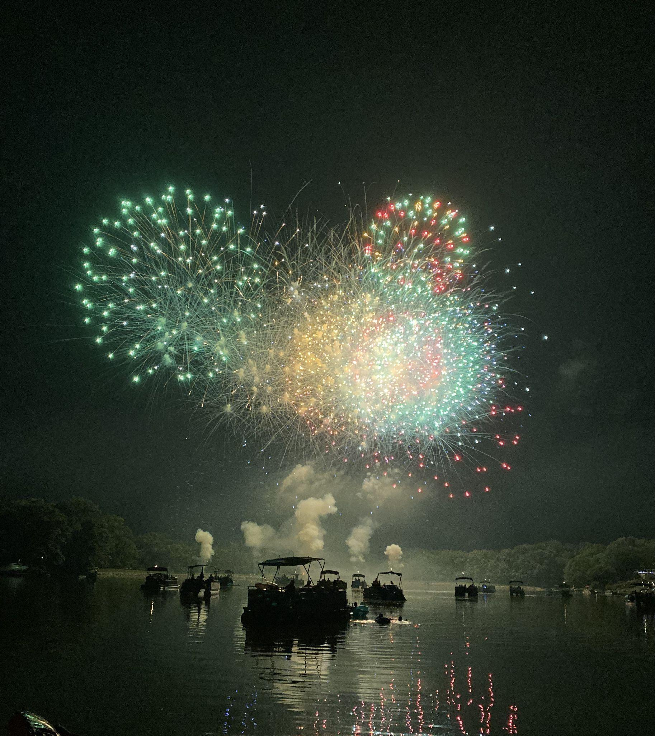
FIREWORKS Josh Schumacher - chair
2024
Fireworks
July 6th
Rainout date 7/7

Slide 7
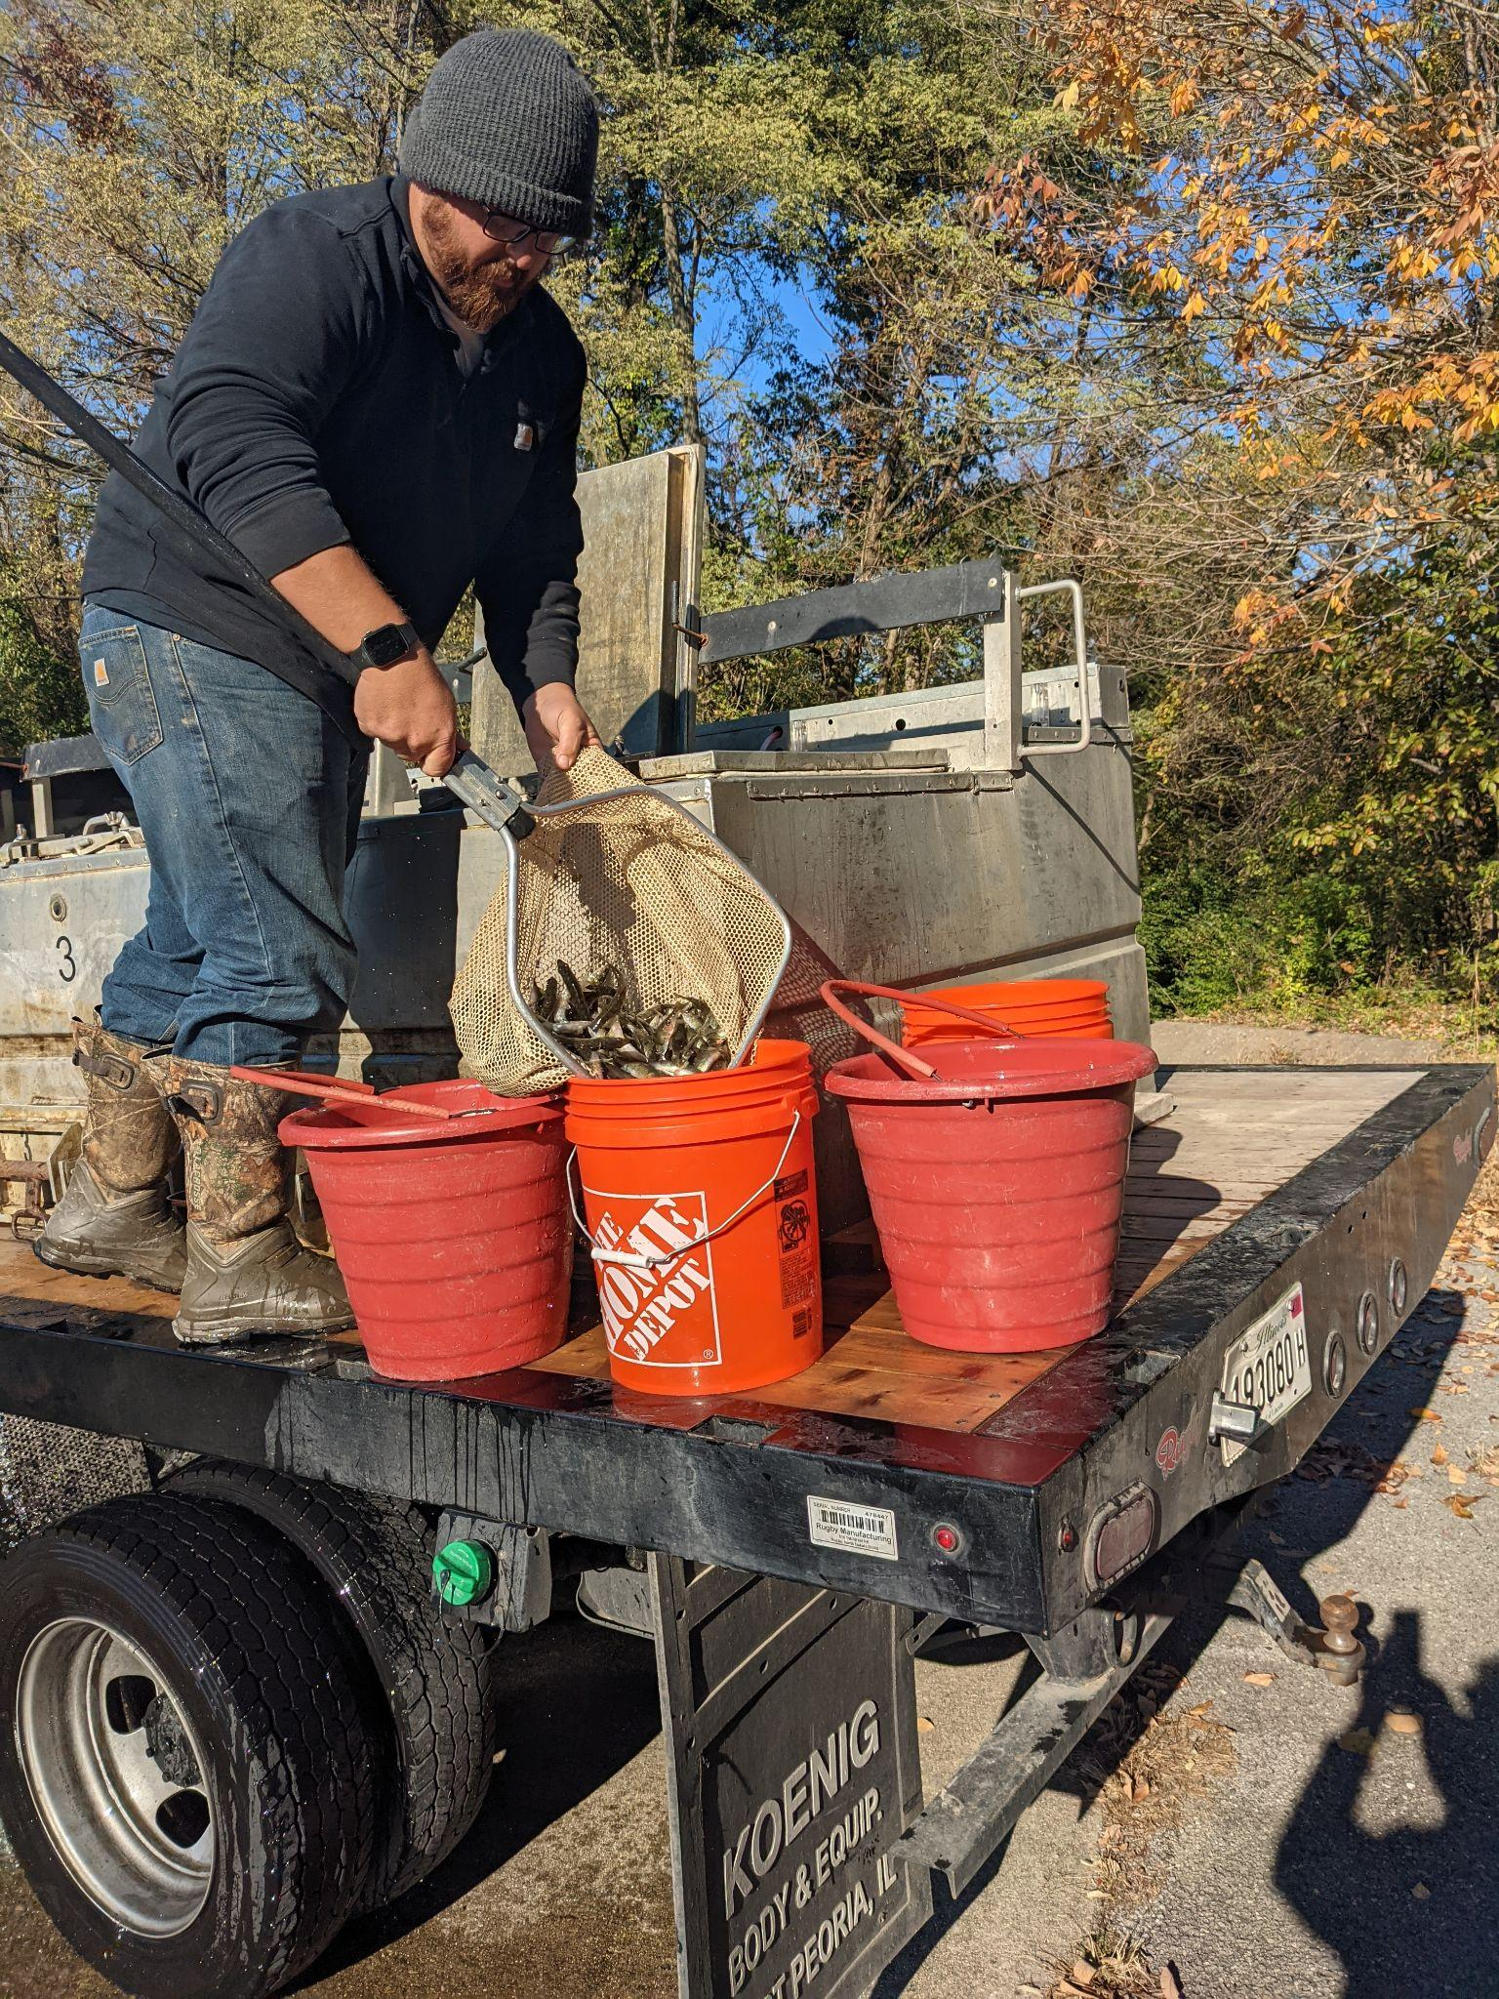
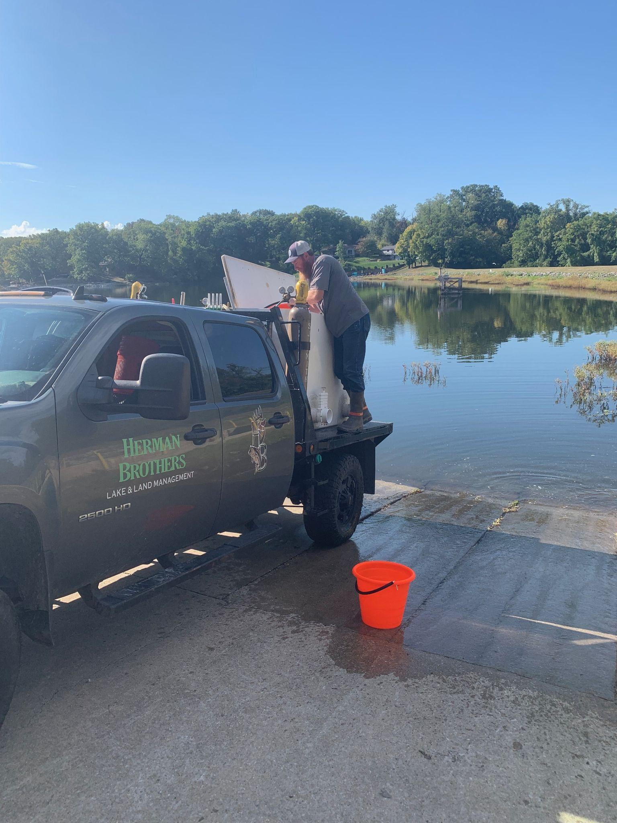
FISH & WILDLIFE Mike Mosella - chair

Slide 8
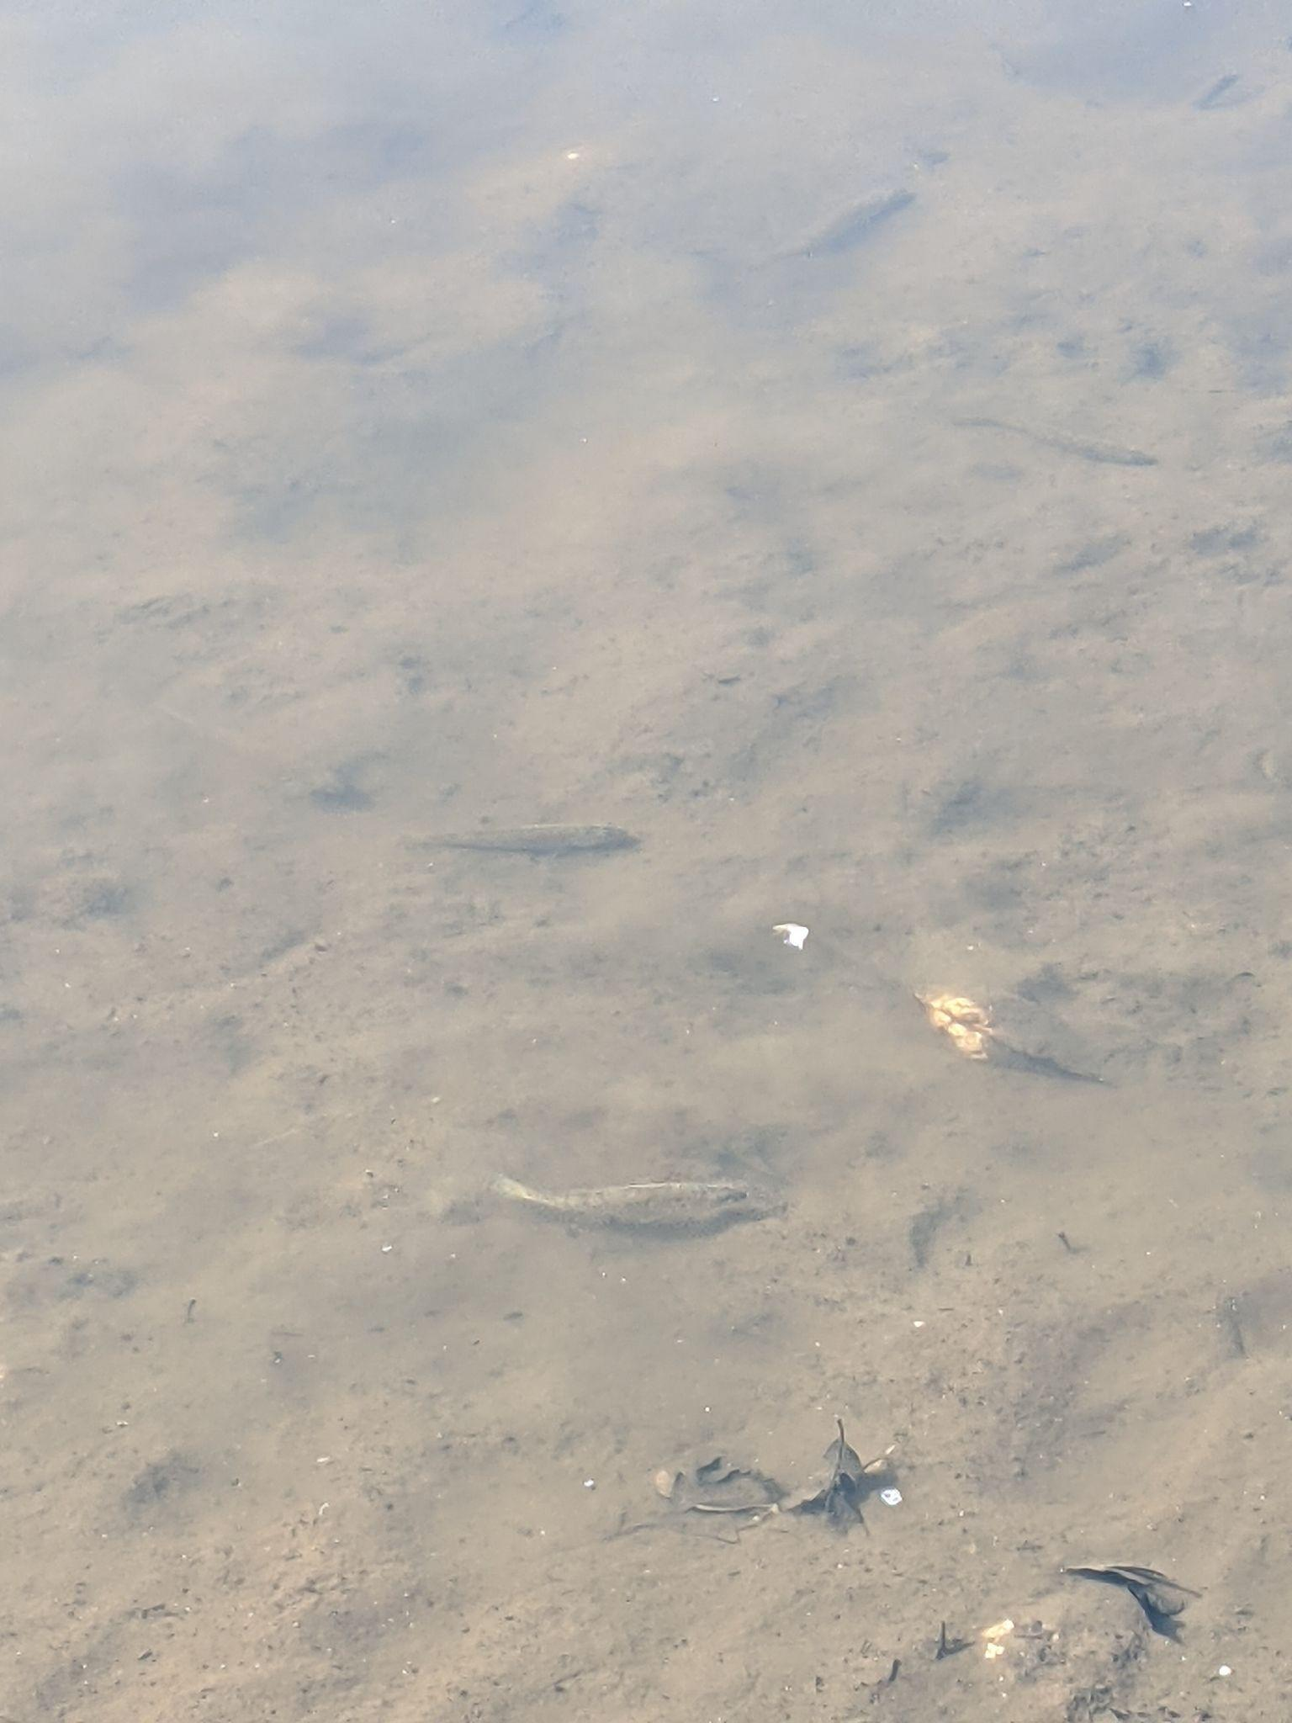
FISH & WILDLIFE
Stocking in 2023
Spring - 25 Muskie
Fall - 725 Largemouth Bass
Goals for Spring of 2024
Electro Shocking via Solitude Lake Management to determine fish counts
3 Artificial Fish Habitats to be anchored in the lake

Slide 9
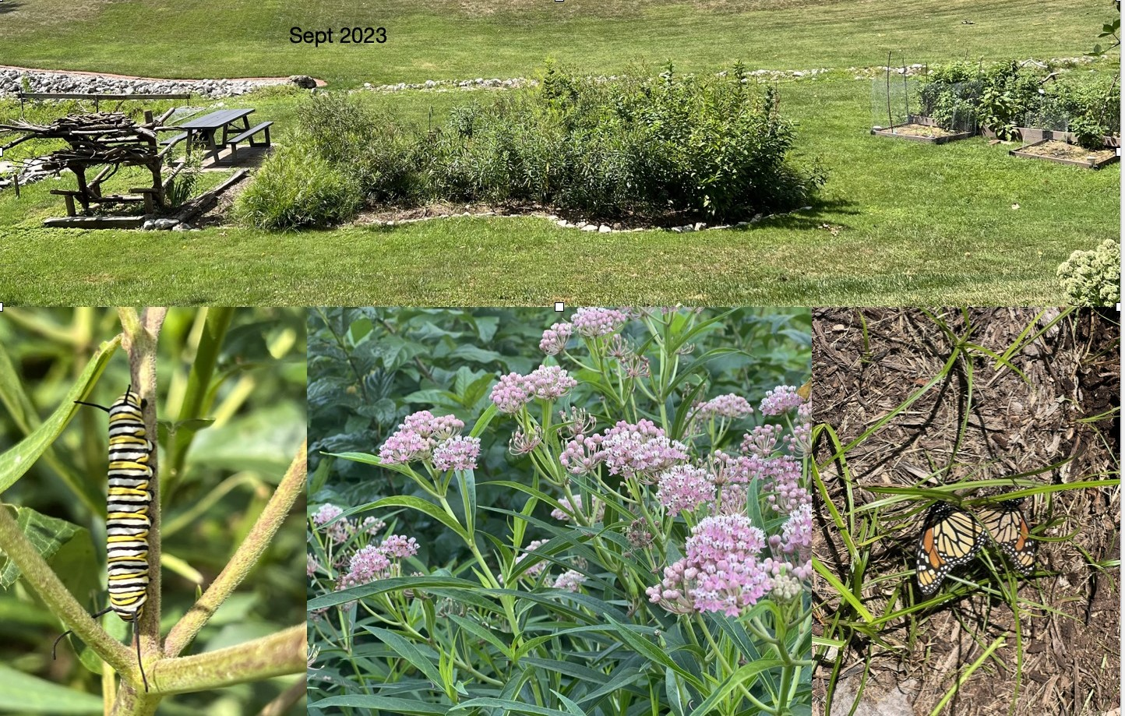
COMMONS COMMITTEE Ryan Beevers – Chair, Maintenance
Lori Scarlett – Beautification
Josh Schumacher – Docks
Lee Frea – Infrastructure

Slide 10
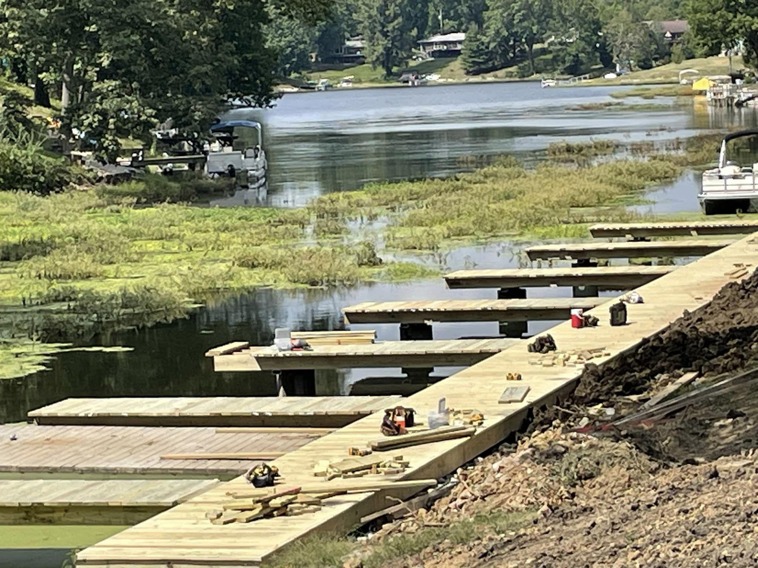
2023 Commons Committee Accomplishments
Increased access for off-lake residents by installing Association owned docks at E3 E4 & W1. All self-funded through lease agreements
Restored depth around docks at E3, E4 & W1
Removed large quantities of garbage & debris from lake bed (tires, toilets, metal & tractor parts)
Organized weed removal efforts

Slide 11
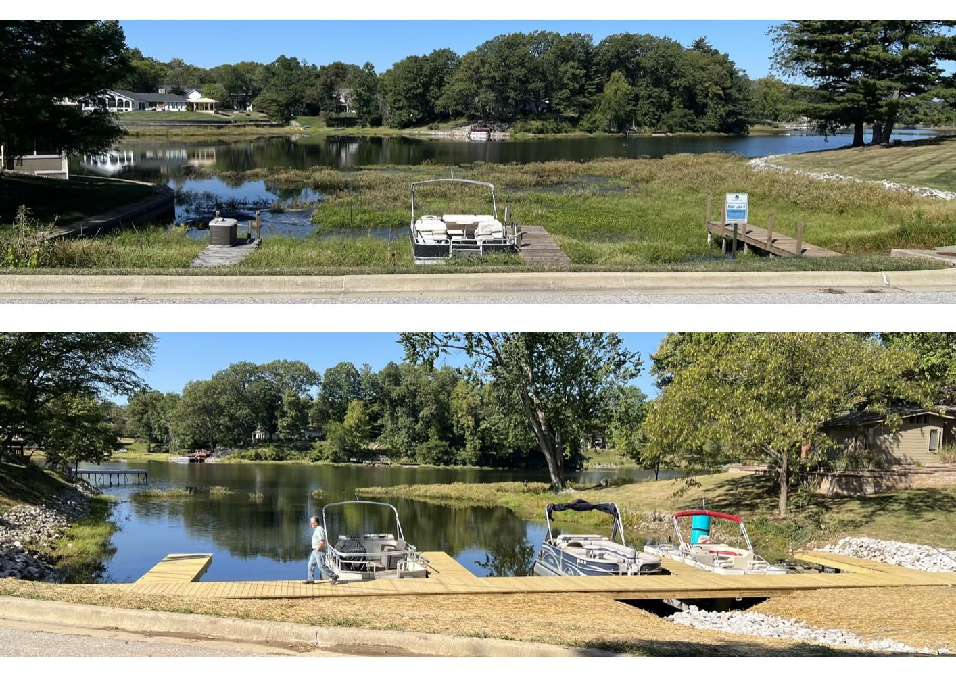
E4 before Marina installation
2024 Commons Committee Goals
maintenance at inflows
maintain and expand native gardens
address commons areas in need of maintenance (please inform the committee of any areas in need)
E4 after Marina installation

Slide 12
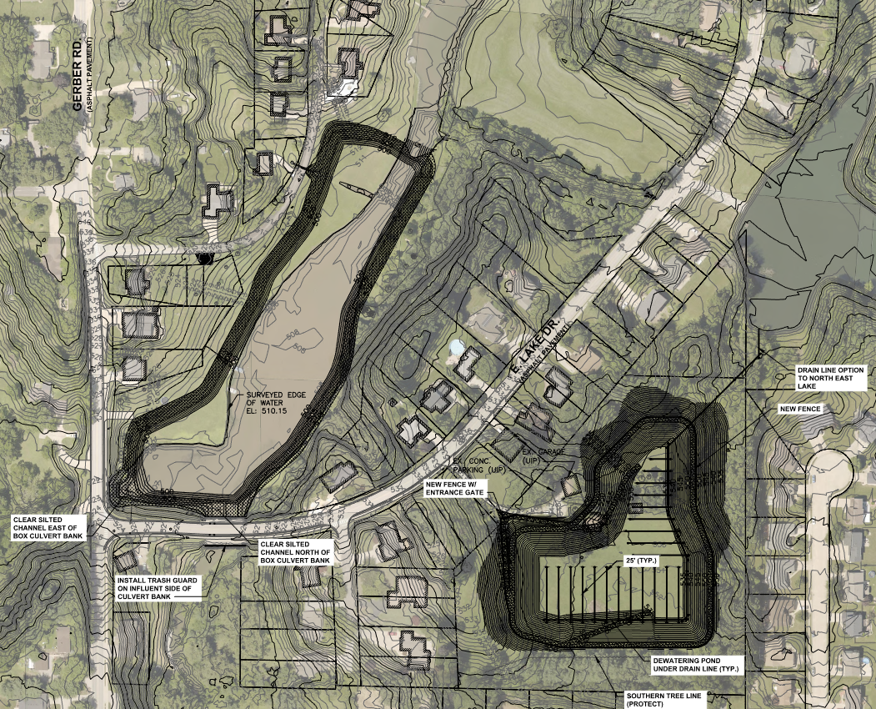
Silt & Erosion
Jim Taylor - Chair
Cove A Depth
Restoration
project completed

Slide 13
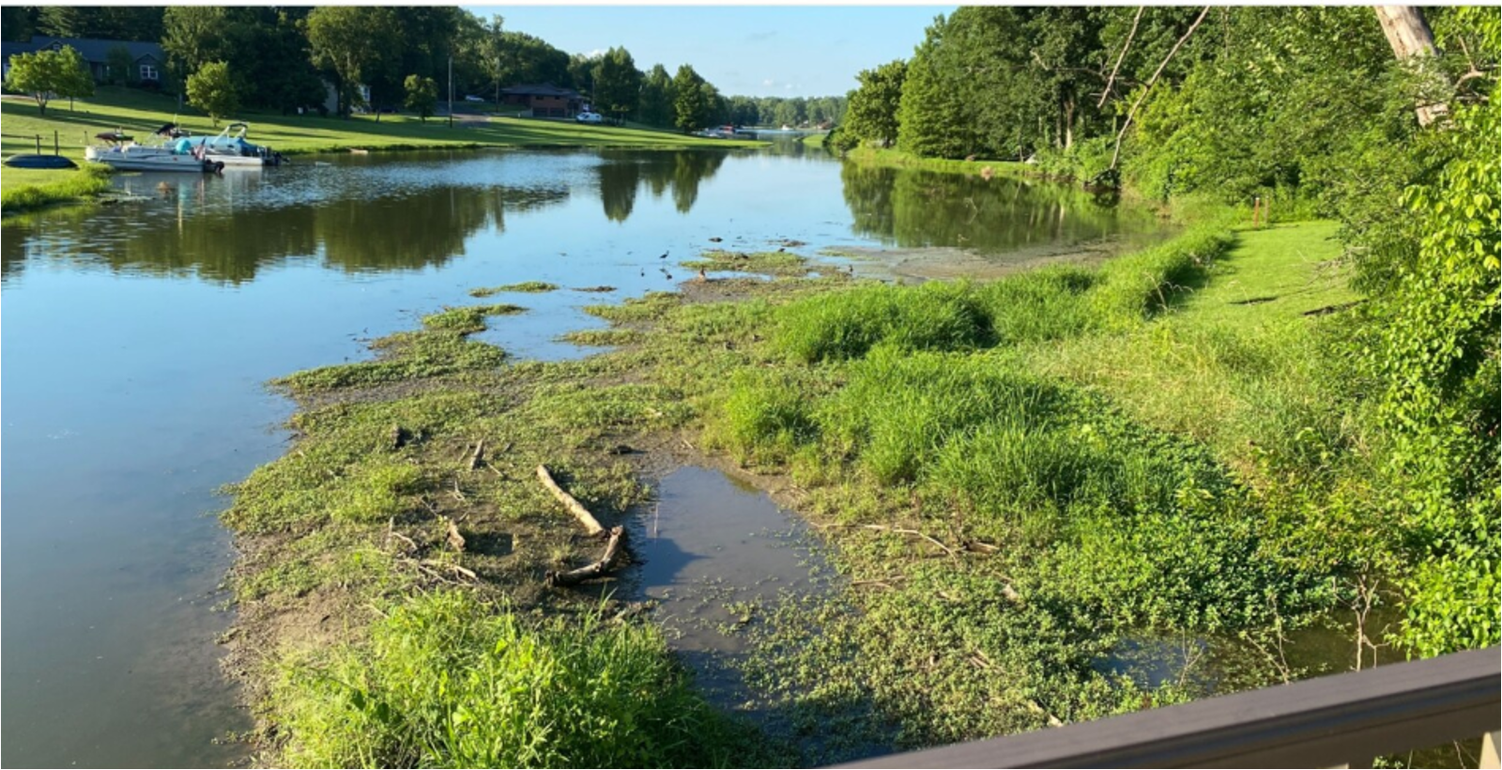
Before

Slide 14
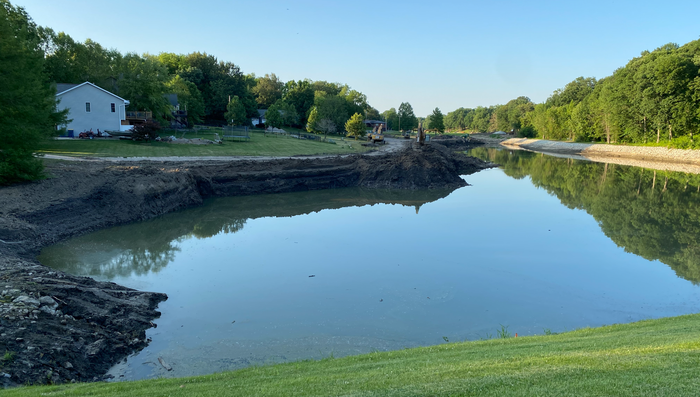
During

Slide 15
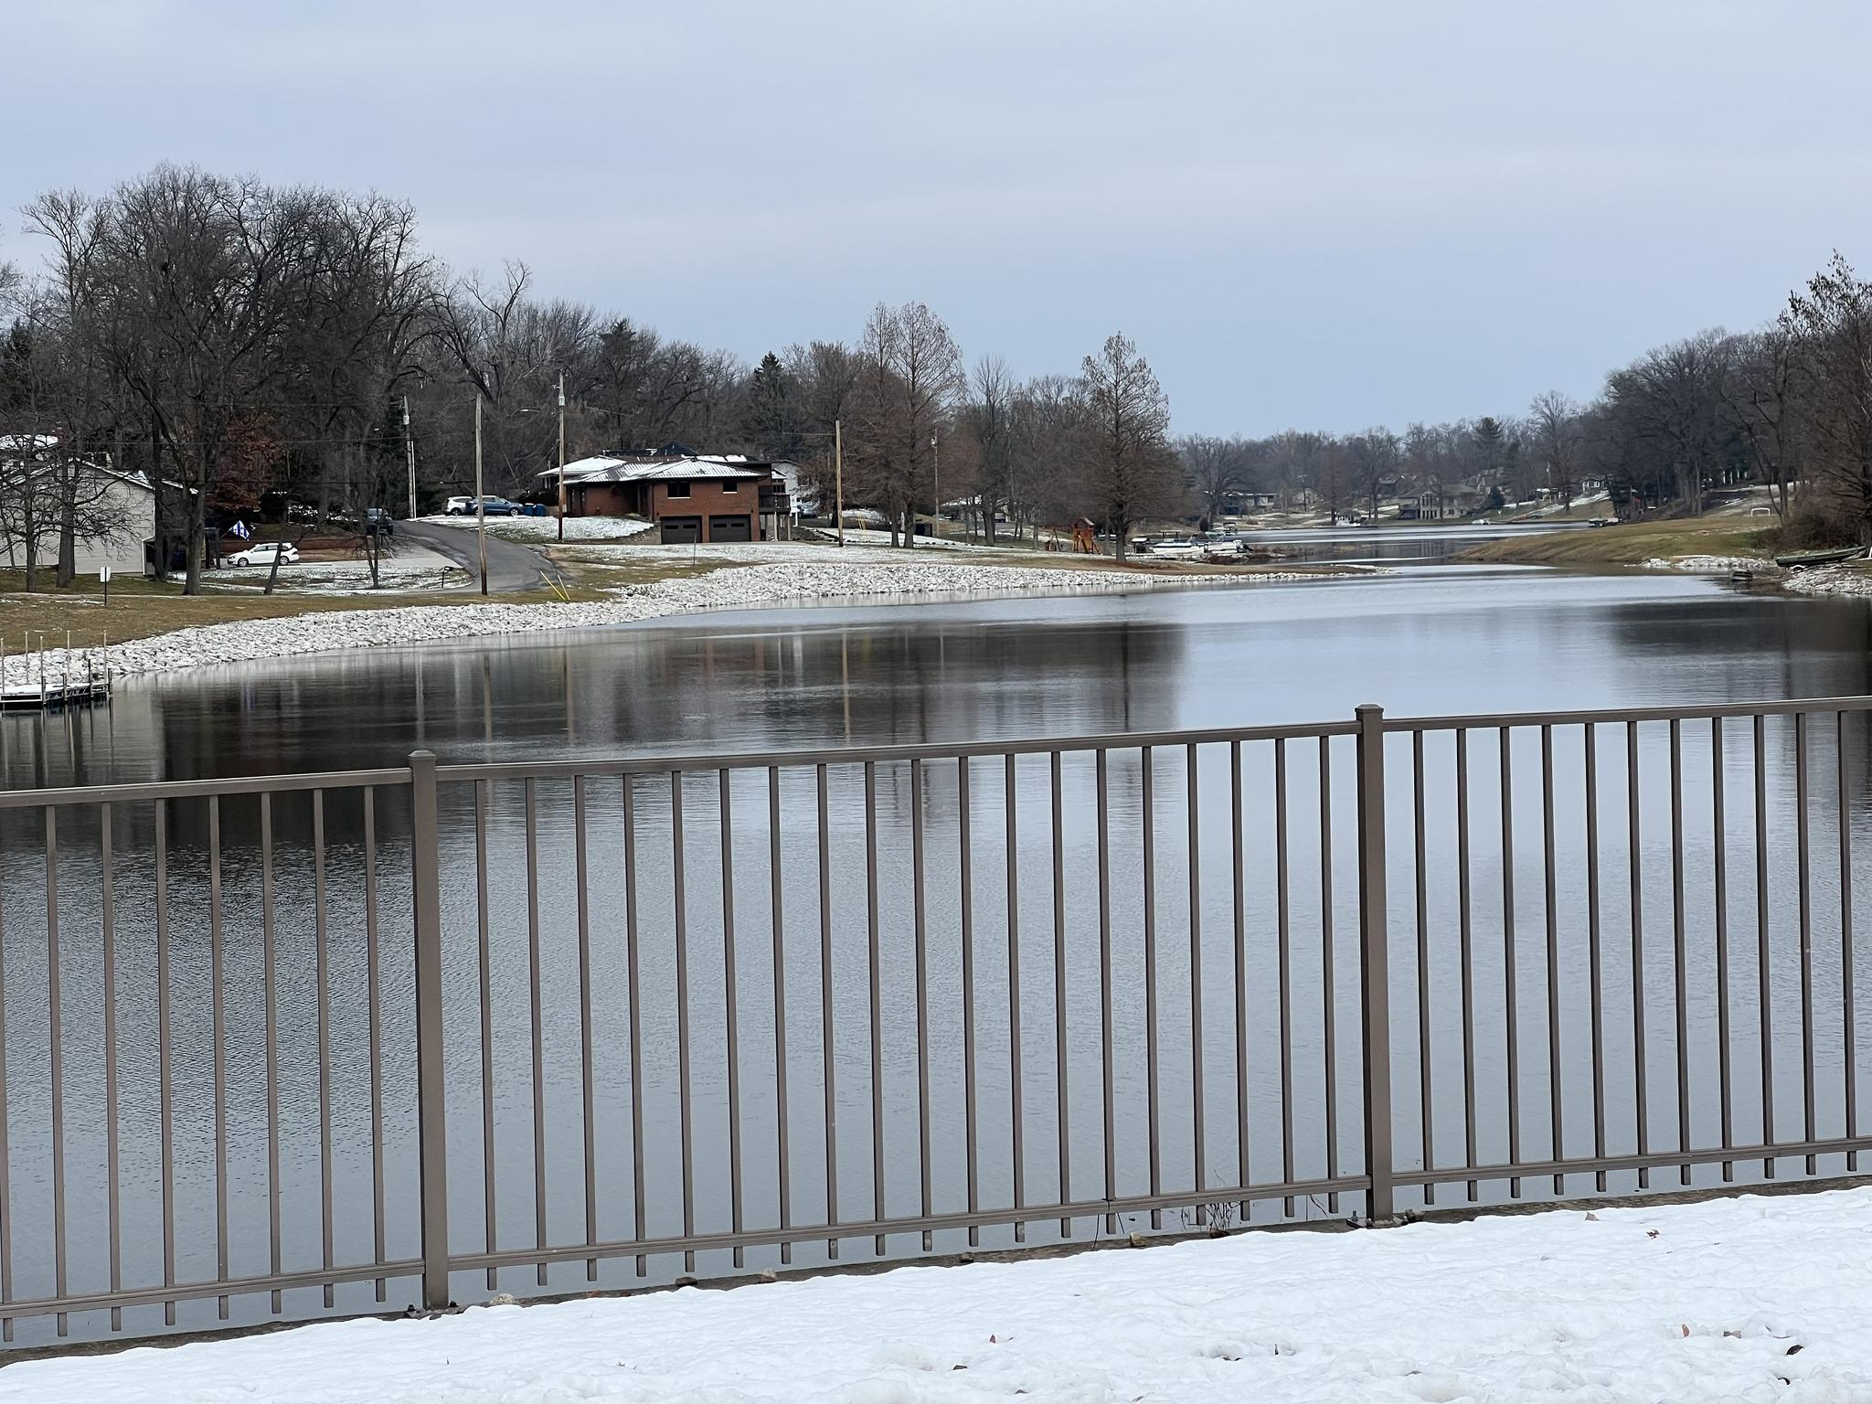
Winter 2023

Slide 16
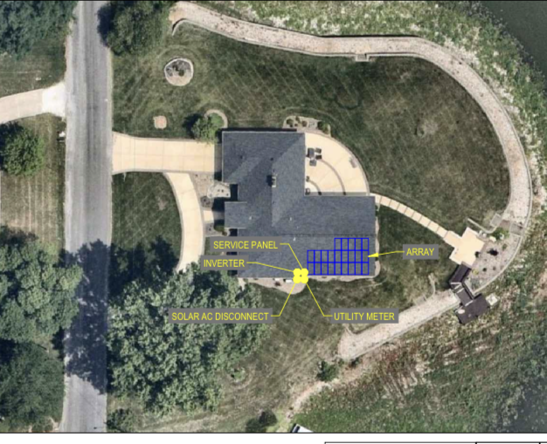
BUILDING COMMITTEE Andy Leek – chair, Terry Reising & Mike Carlson
32 Building Permits Issued
including 9 permits for solar panels

Slide 17

COMMUNICATIONS COMMITTEE Erik Manning - Chair
Monthly newsletters.
Association Facebook page, Private Facebook group, www.DunlapLake.org
15 New Residents welcome letters.
DLPOA Official Announcement Postings:
Signboards
840 East Lake Drive
Corner of Barnett & Schwarz

Slide 18
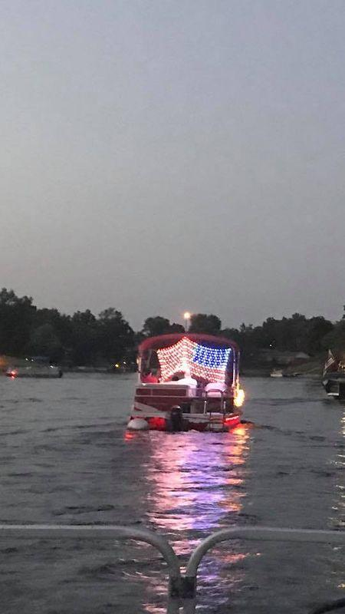
Safety Committee
John Bode - chair
2024 Goals
Implement new system for applying for boat stickers and maintaining sticker database
Continue to perform water testing
Continue to urge residents to apply for boat stickers and display on boats in proper location
Update safety signage
2023 Accomplishments
Updated and maintained database for boat stickers
Continued to urge residents to apply for boat stickers for new boats and boats
purchased from other or previous residents
Monitored boats without stickers and sent notices to register boat with the Association
Water testing
Goals for 2024
Work to integrate SmartSheet as platform for boat sticker applications and to maintain boat sticker database
Work to update signage around lake

Slide 19
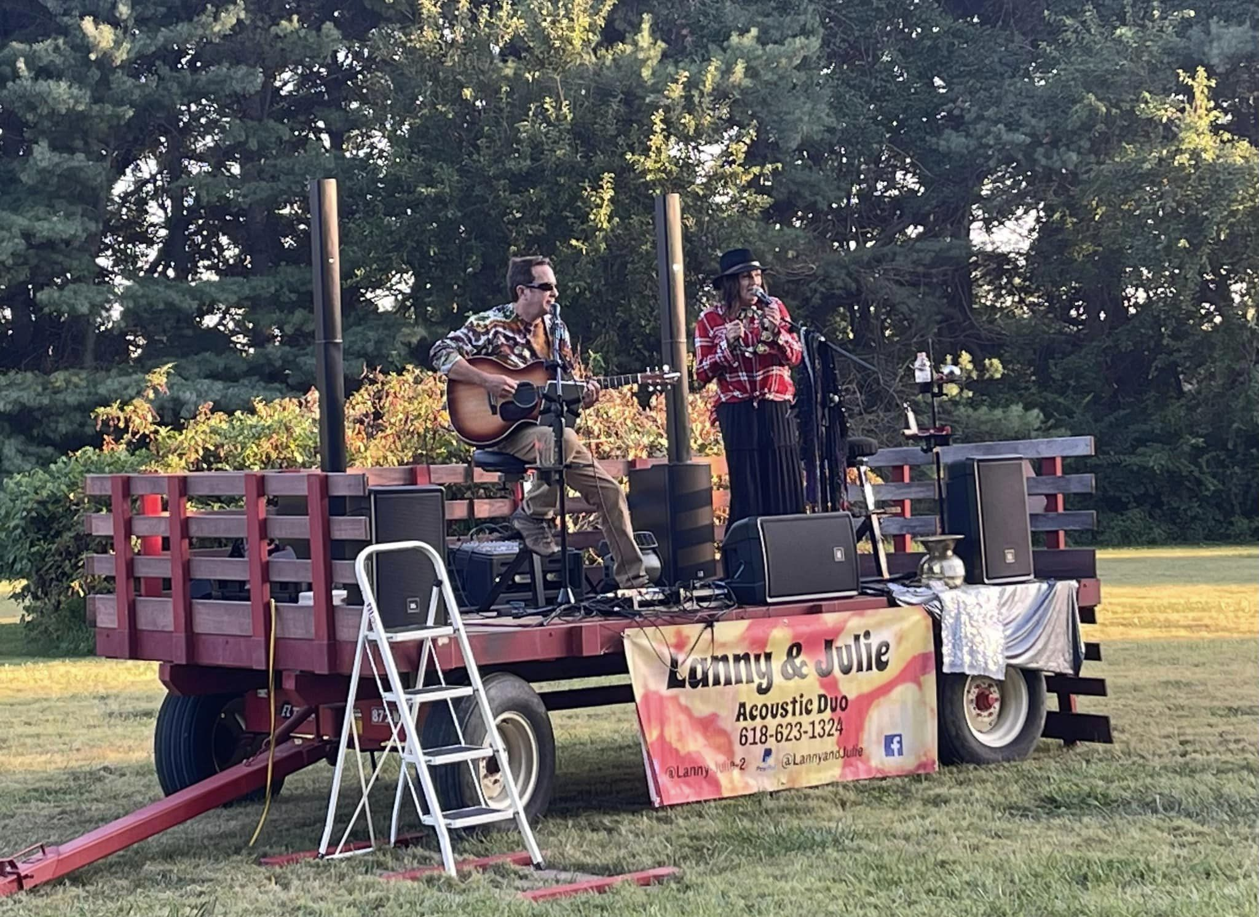
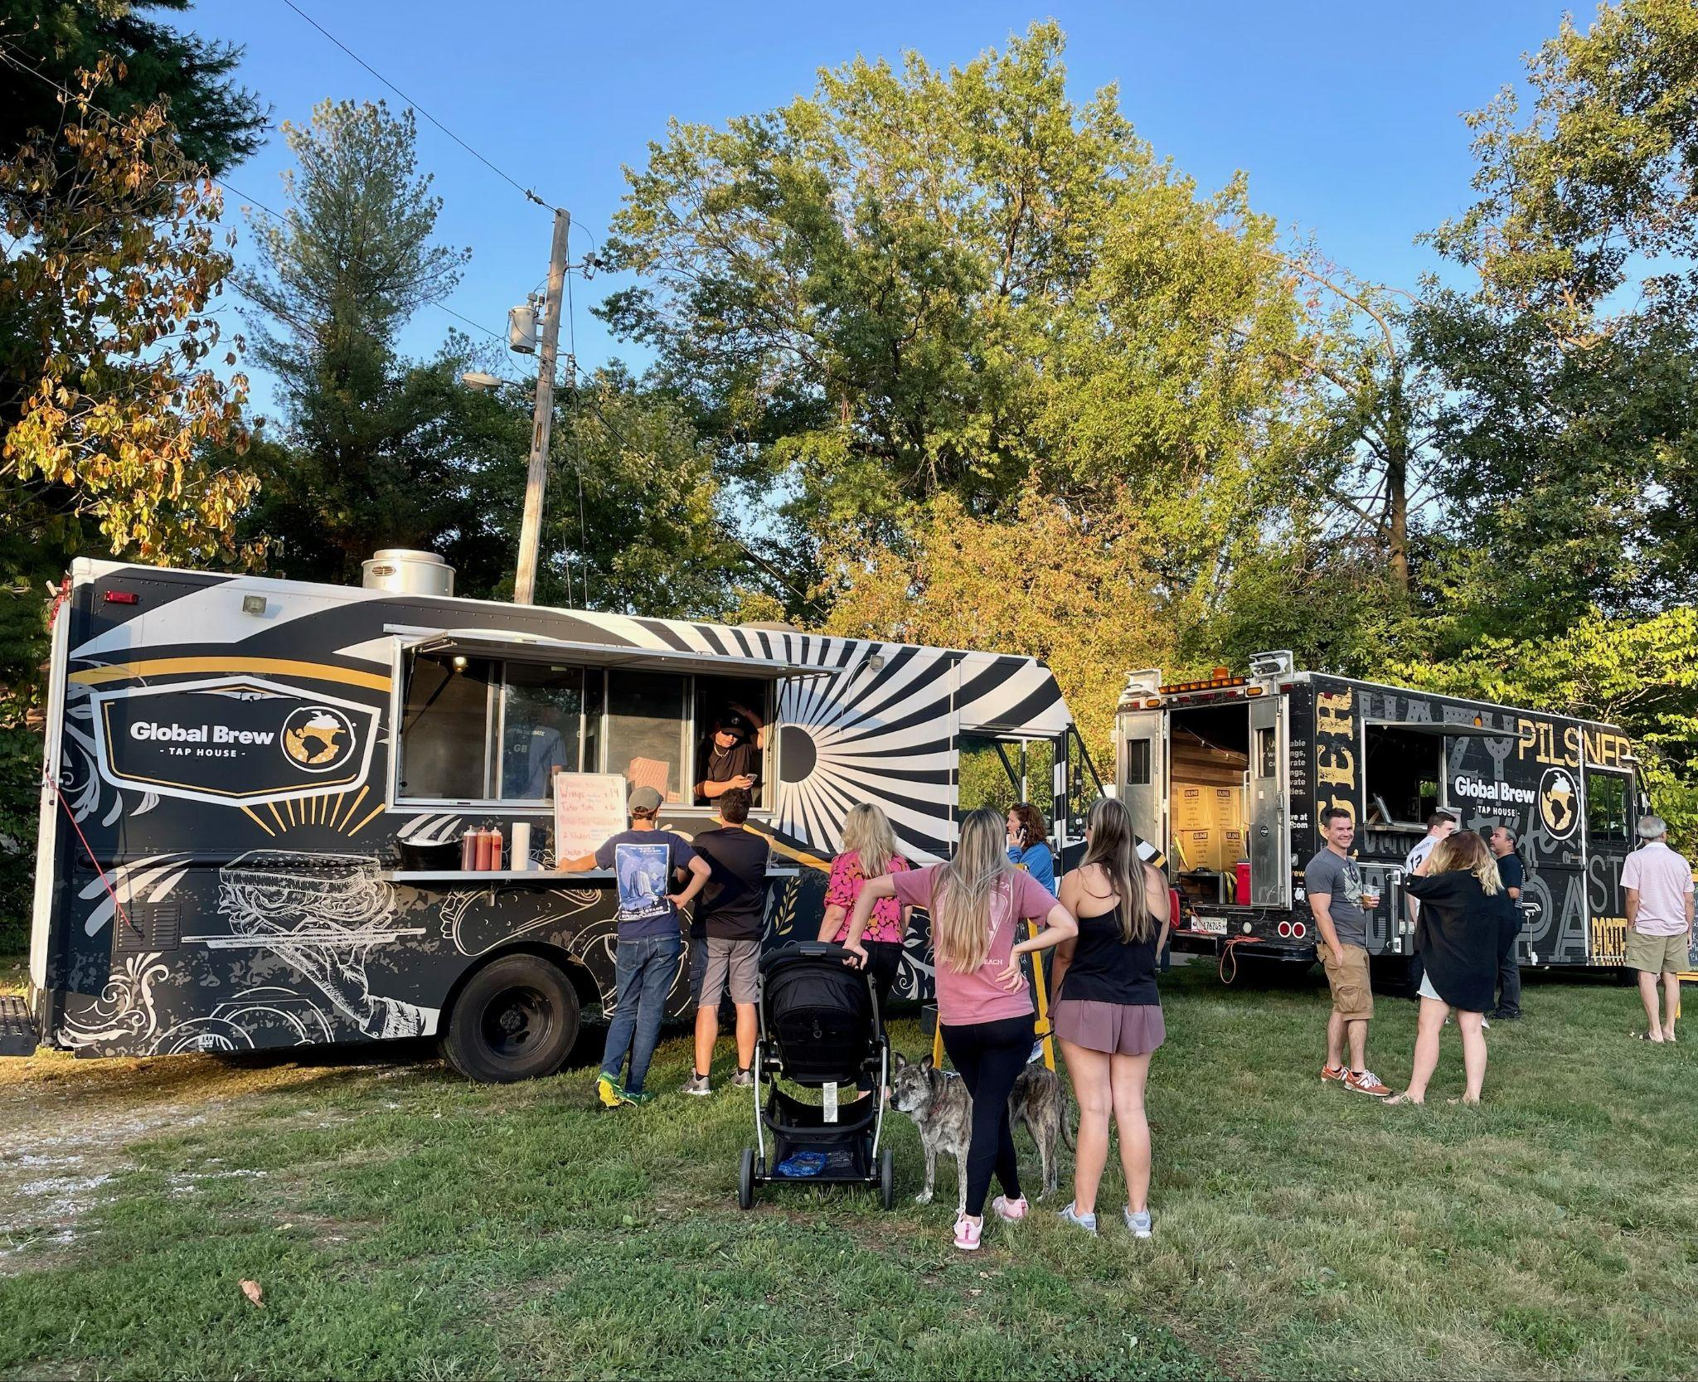
Meetings, Election & Social
Frank Gremaud - Chair
2023 was a slower year for the lake with Capital Improvement Projects
The Annual Block party continued to grow with great tunes from Lanny and Julie
Chicken dinner in January 2024 was successful once again, raising nearly $800
2024 Goals
For 2024, we are really looking forward to bringing back some of the classic events like the lighted boat parade and adding new ones
Annual Block Party
Lighted Boat Parade
Annual Chicken Dinner
Poker Run
Other possible events: Golf Scramble, Trivia Night, Christmas event, Fishing Tournament

Slide 20
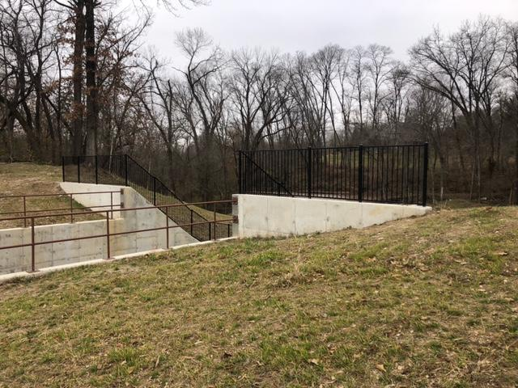
Dam & Maintenance
Roy Wehling - Chair

Slide 21
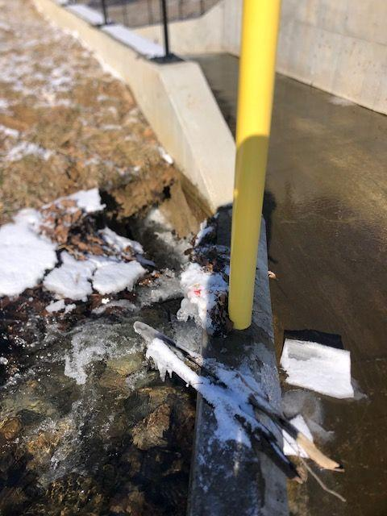
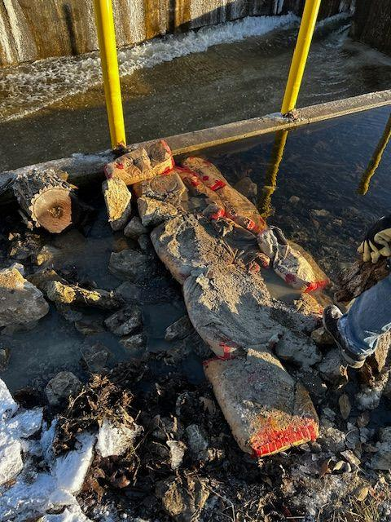
Dam Committee

Slide 22
You do not need to be a board member to join a committee.
We are always looking for new volunteers and new events.
www.dunlaplake.org/volunteer/
Or email Carolyn@DunlapLake.org

Slide 23
ELECTION OF NEW
BOARD MEMBERS
Frank Gremaud - chair
meetings, elections and social committee

Slide 24
ELECTION OF NEW BOARD MEMBERS
Volunteers for term
Graham Johnson
Andy Leek
Lori Scarlett
Roy Wehling
Andrew Reznack

Slide 25
2024 PROPOSED Operations BUDGET
Rick Welle Treasurer

Slide 26
DLPOA Loan Status
Table 1
 | Rate | Date | Payment | Balance | Date | Borrowed
SPILLWAY | 3.99 | 01.23.24 | $5,000.00 | $461,079.66 | 03.23.27 | $492,000.00
ENGINEER | 3.99 | 01.23.24 | $3,500.00 | $448,714.89 | 03.23.27 | $465,000.00
BASIN | 8.75 | 02.14.24 | $8,316.75 | $1,103,790.60 | 02.14.28 | $1,115,000.00
TOTAL DEBT |  | 02.23.24 | $16,816.75 | $2,013,585.15 |  | $2,072,000.00
 | Payouts | 04.27.23 | $142,177.50
 |  | 05.22.23 | $152,752.50
 |  | 06.06.23 | $272,749.50
 |  | 06.26.23 | $291,251.25
 |  | 08.14.23 | $209,198.07
 |  | 11.09.23 | $35,661.78
 | Total |  | $1,103,790.60 |  | Remaining loan amt | $11,209.40
3 outstanding debts

Slide 27
DLPOA Cash Assets
As of 02.23.2024
Institution Type of Account Amount
Busey Bank Savings $ 10,642.92
First Citizens Debit card $ 1,288.38
First Mid Savings $ 344,512.49
First Citizens Operating Fund $ 93,994.60
First Citizens Special Projects $ 40,988.05
First Mid Certificate of Deposit $ 200,000.00
Total $ 691,426.44

Slide 28
Proposed Budget
As of 02.23.2024
Table 1
Fund | Amount
Operating Assessments | $189,408.00
Operating (Other) | $622.00
Total Operating | $190,030.00
Reserve Assessments | $189,000.00
Total Income | $379,030.00

Slide 29
YTD Expenses (Operations)
As of 02.23.2024
Table 1
Category | Amount
Administration | $41,178.00
Fish & Wildlife | $2,825.00
Grounds | $57,737.00
Social | $8,626.00
Insurance | $4,290.00
Taxes | $3,085.00
Total | $117,741.00

Slide 30
YTD Expenses (Capital Projects)
As of 02.23.2024
Table 1
Category | Amount
Spillway/Dam | $17,973.00
Engineering/Expansion | $10,972.00
Silt Retention Basin | $51,723.00
Total | $80,668.00

Slide 31
Table 1
 | Description | 2023-24 Amount |  | 2024-25 Proposed
 | Assessment Income | $180,000 |  | $180,000
 | Lake Assessments | $168 |  | $168 | Total Billable units = 367
 |  | $180,168
 | Misc. Owner Income | $1,380 |  | $1,500
 | Boat Stickers | $400 |  | $400
 | Interest Income | $400 |  | $400
 |  | $2,180
 |  | $182,348 |  | $182,468

Slide 32
Table 1
 | Administration | 2023-24 |  | Proposed
 | Management Fees | $6,000 |  | $6,000
 | Association Manager | $25,980 |  | $27,019
 | Heartlands Conservancy | $15,000 |  | $5,000
 | Accounting & Prof Fees | $700 |  | $700
 | Legal Fees | $10,000 |  | $10,000
 | Boat Stickers | $1,000 |  | $1,000
 | Computer and Software Exp | $300 |  | $1,000
 | Web Domain & Hosting | $600 |  | $600
 | Elections & Voting | $2,000 |  | $2,000
 | Financial Admin |  |  | $0
 | Member Communications | $1,200 |  | $1,200
 | Office Supplies | $2,100 |  | $1,500
 | Onsite Postage | $900 |  | $900
 | Water Testing | $1,200 |  | $1,200
 | Miscellaneous Admin | $800 |  | $800
 |  | $67,780 |  | $58,919

Slide 33
Table 1
Fish & Wildlife | 2023-24 |  | Proposed
Fish Toxins Lab Work | $750 |  | $750
Fishing Derby | $400 |  | $400
Fishing Tournament |  |  | $0
Lake Stocking | $4,000 |  | $6,000
Traps & Bait | $1,000 |  | $1,000
 | $6,150 |  | $8,150

Slide 34
Table 1
Grounds | 2023-24 |  | Proposed
Signage | $1,500 |  | $1,500
Lawn Care | $24,000 |  | $25,000
Dam Maintenance | $3,400 |  | $17,000
Dam Inspection | $2,000 |  | $2,500
Dam Repairs & Maintenance | $4,000 |  | $4,000
Silt & Erosion Eng, Survey & Design | $5,000 |  | $22,000
Silt & Erosion Interest Exp |  |  | $0
Shoreline & Area Maintenance | $3,000 |  | $3,000
Inflow Maintenance | $8,000 |  | $8,000
840 Property - Miscellaneous | $600 |  | $600
840 Property - Mow & Landscape | $4,000 |  | $0
840 Property - Utilities | $2,000 |  | $1,500
Miscellaneous Grounds | $2,000 |  | $2,000
Lake Debris Cleanup | $2,000 |  | $2,000
 | $61,500 |  | $89,100

Slide 35
Table 1
Other | 2023-24 |  | Proposed
Fireworks & Deposit | $8,000 |  | $8,000
Social Activities | $2,065 |  | $2,400
Member Meeting | $700 |  | $700
Bonfire | $250 |  | $250
Holiday Party | $500 |  | $500
 | $11,515 |  | $11,850
Insurance | $5,000 |  | $5,000
 | $5,000 |  | $5,000
Taxes | $4,000 |  | $4,000
 | $4,000 |  | $4,000
Total | $155,945 |  | $177,019

Slide 36
Anticipated Capital Projects
After final stepped increase
$252,000 assessment income
$8,000 interest income
$208,500 loan payments ($17,400/mo.)
$51,700 “spread”

Slide 37
Final Notes
Grant Income, outstanding expenses
Received $350,852.54 stormwater/erosion grant from EPA
Anticipating approximately $15,000 more of grant; this will be close to a wash with remaining hold-back with Stutz for silt basin expansion
Approximately $8500 in emergency spillway/dam repairs will be paid out of 2023-24 budget

Slide 38
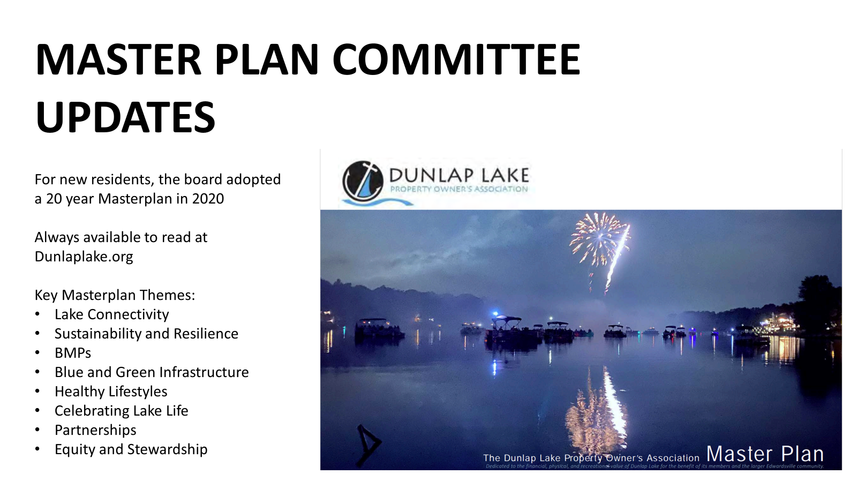

Slide 39
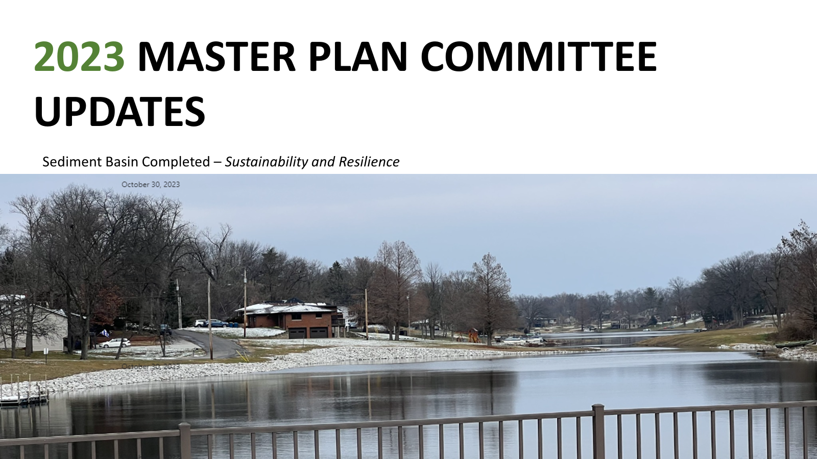

Slide 40
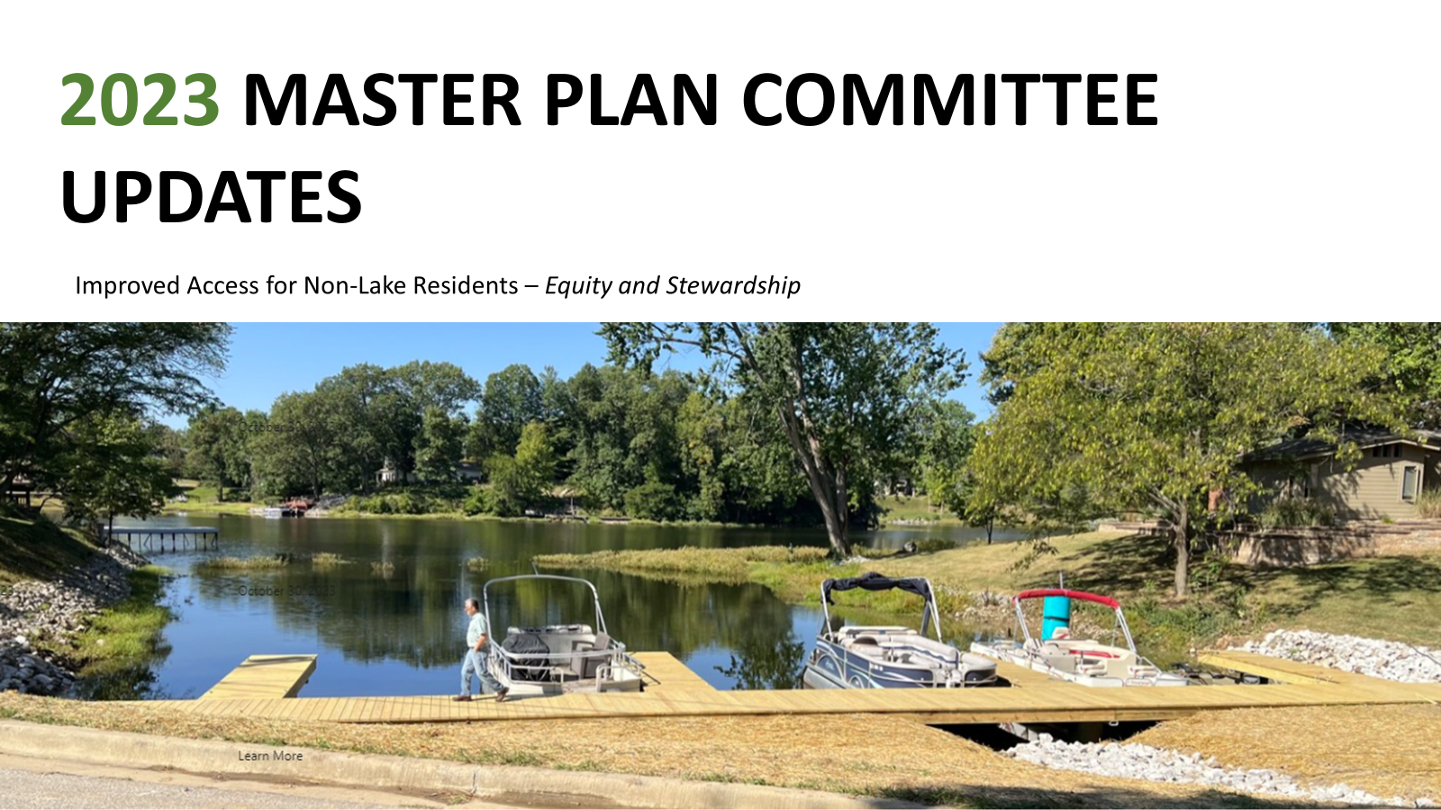

Slide 41
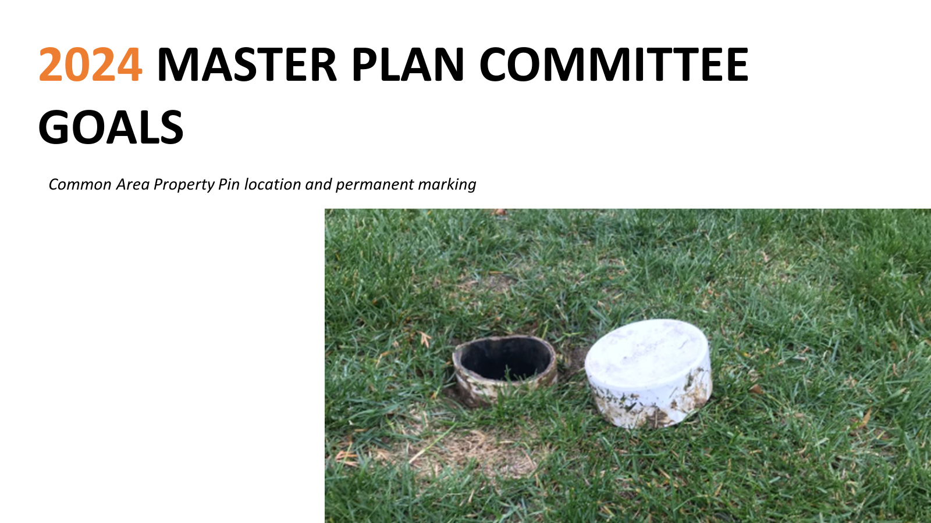

Slide 42
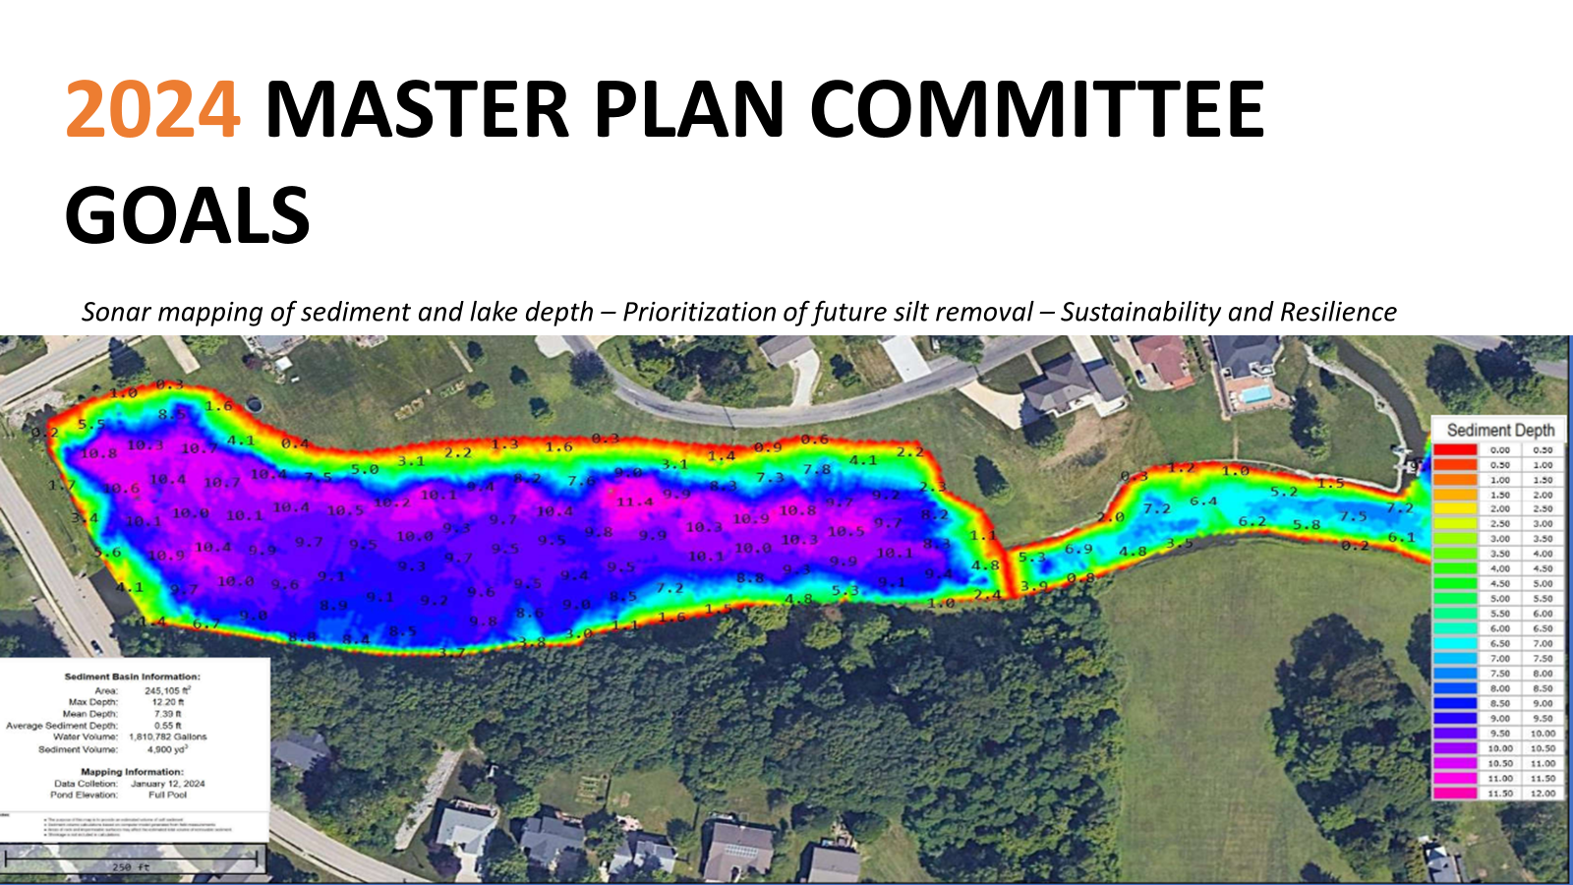

Slide 43
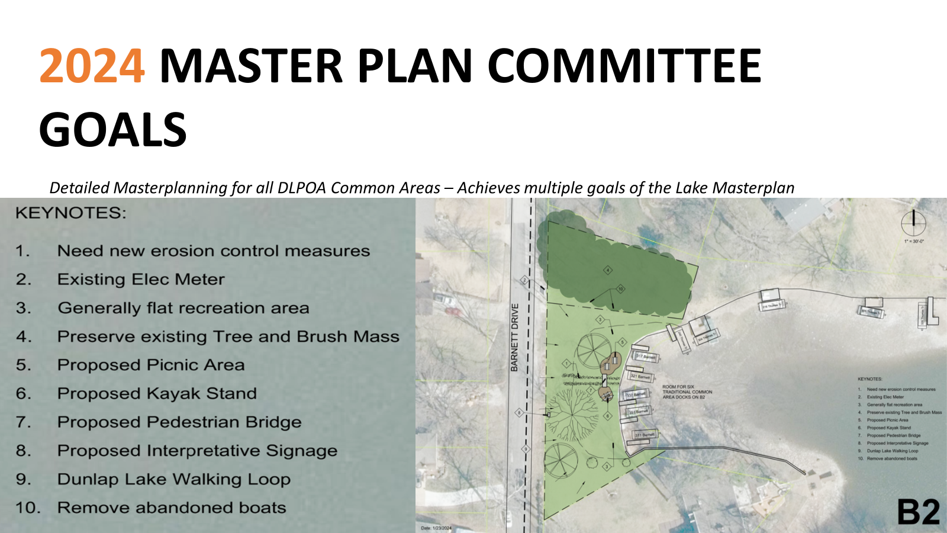

Slide 44


Slide 45
Goals
Andrew Reznack

Slide 46
Goals for Fiscal 2024-25
Financial
Reduce Debt
Maintain full funded capital reserves
Stay within Operational budget
Future Projects
Baseline our current depth levels via sonar
Preliminary Roadmap for future projects
Operational
Re-establish fish population
Common Area Beautification
Lake Clean up

Slide 47

Thanks for Attending
Exciting things are happening at Dunlap Lake. To join a committee please email manager@dunlaplake.org

