Slide 1
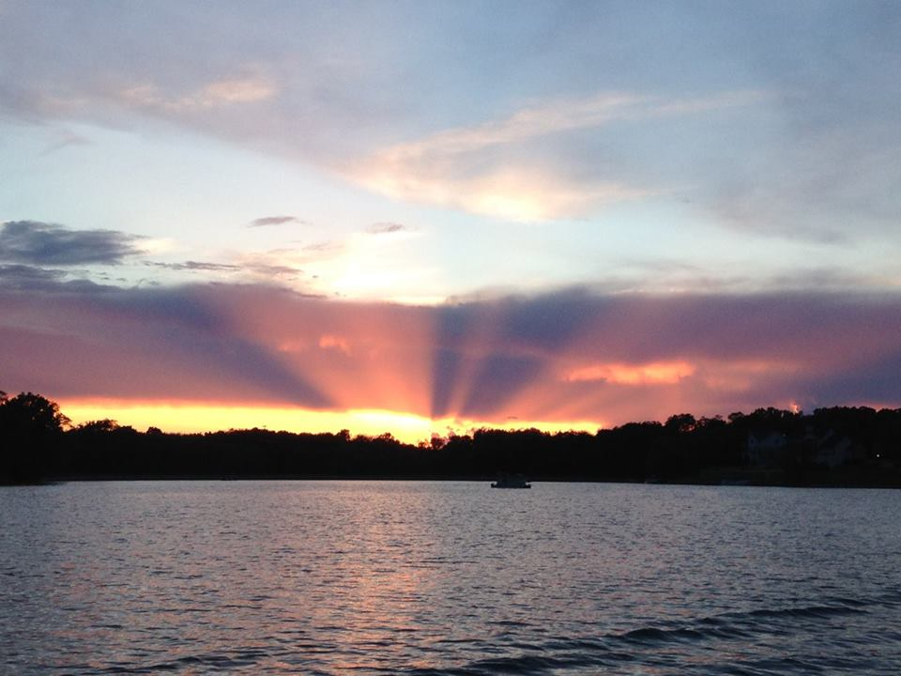
2017 Annual Meeting
Dunlap Lake Property Owners Association

Slide 2

AGENDA
Call to Order & Welcome
Special Presentation
  Mayor Hal Patton
Petition to exit DLPOA/Request to Join
Board Introductions
New Candidate Introductions & Election
2016 Financial Report
  Proposed FY 2017 Budget
Committee Reports
Election Results
New Business

Slide 3
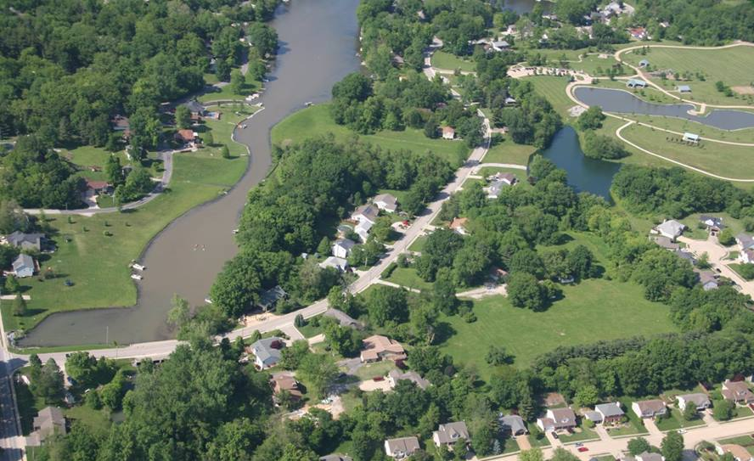

.
Special Presentation
.
City of Edwardsville Mayor Hal Patton

Slide 4
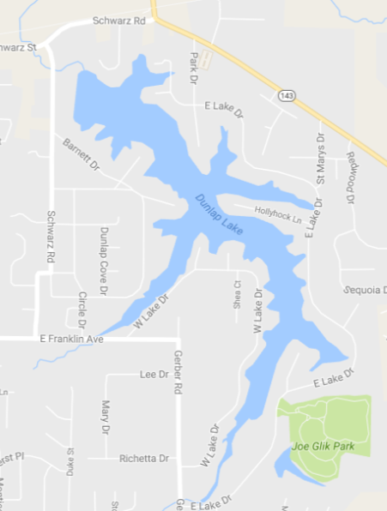
Dunlap Lake Property Owner’s Association
Dredging Project and Special Services Area
Discussion Points

Slide 5
Dredging Project
  Estimated cost is $4.5 million
  There are 355 lots within the boundaries of the Dunlap Lake Property Owner’s Association (DLPOA).
  The dredging project cost divided equally between the property owners equals approximately $12,600, without interest.
General Comments
  There is no “perfect system” to pay for the dredging project.
  The use and enjoyment of Dunlap Lake varies greatly from one property owner to another.
  Large homes, small homes, vacant lots, and off-lake property have all contributed and benefitted from being part of Dunlap Lake subdivision.

Slide 6
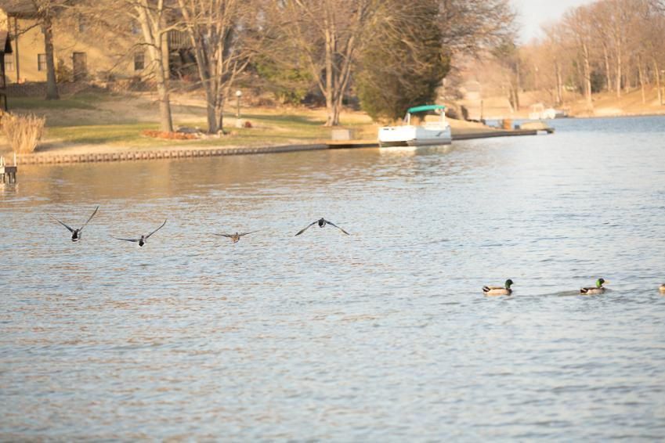
Courtesy of Matt Miller/SmashHousephotography.com

Slide 7
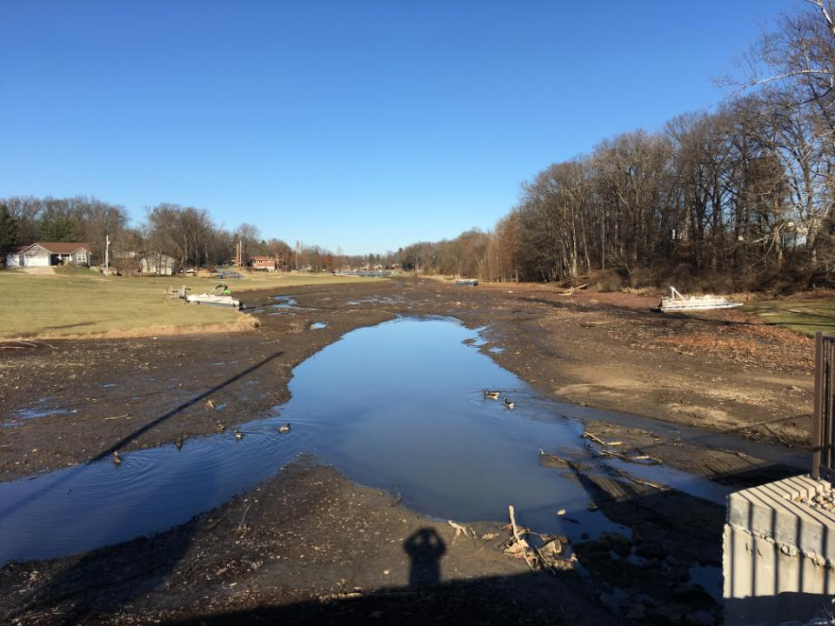

Slide 8
DLPOA
  August 31, 2016 – a vote was held asking members if they supported the $4.5M dredging project and the creation of a Special Services Area (SSA) by the City to finance the project. Scheffel Boyle delivered the following vote results to the DLPOA Board on September 3, 2016:
      74% of the possible votes were cast
      61% voted in favor of completing the project with a SSA
      39% voted against proceeding with the project by establishing a SSA.

Slide 9
Regional Storm Water Management Area
  The City defines the area as part of a regional system to manage storm water in a high-growth area of our community. The City will be partnering with the Madison County Storm Water Management Commission and applying for grants.

Slide 10
City has and should play a role in protecting and improving value in Dunlap Lake subdivision.
  Street Improvements
    The total improvement costs for the various projects along East Lake Drive total $2,962,460.68.
      Phase 1 - $549,661.49
      Phase 2A & 2B - $1,443,101.40
      Culverts near 612 E. Lake - $71,136.00
      Emergency Culvert Replacement - $898,561.79

Slide 11
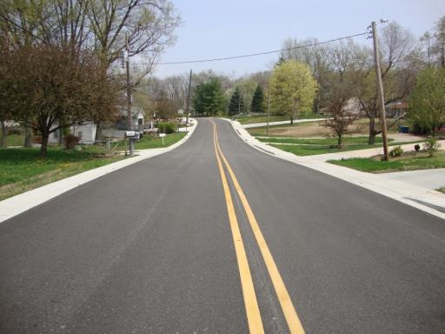
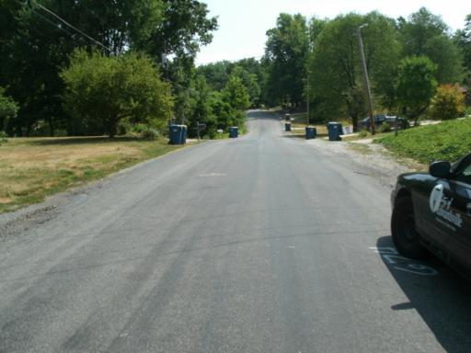
East Lake Drive

Slide 12
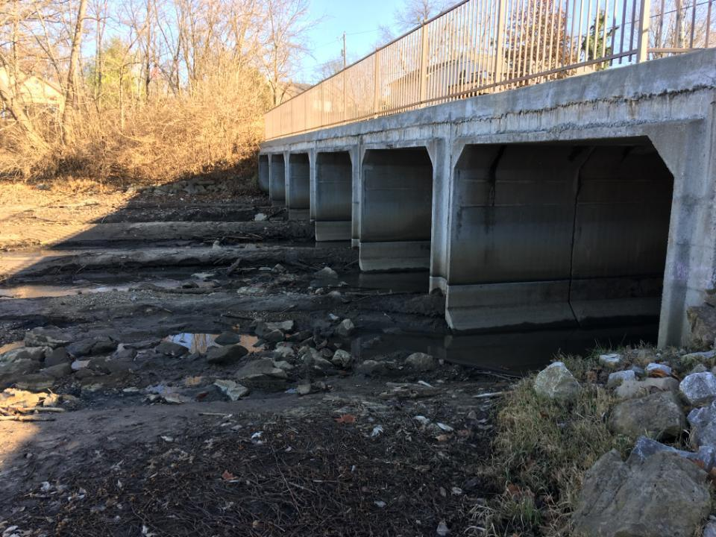

Slide 13
  Glik Park Improvements
    The total improvement costs for various park projects to date - $2,113,500
      Property purchase - $460,000
      Phase I development - $890,000 (road entrance, parking lot, main and secondary trails, restrooms, pavilions, playground, utilities)
      Phase II development - $438,000 (trail extension, lake construction, peninsula/fishing deck, basketball and volleyball courts, utility extensions)
      Phase III development - $125,000 (trail extension to south of upper lake)
      Lower lake walking trail extension - $102,000
      South restroom/pavilion/utility extension - $98,500

Slide 14
  Glik Park Improvements
    Projected final phase $1,275,000
        Programming/restroom/maintenance building - $550,000
        Main parking lot - $550,000
        Connecting roadway and infrastructure - $175,000

Slide 15
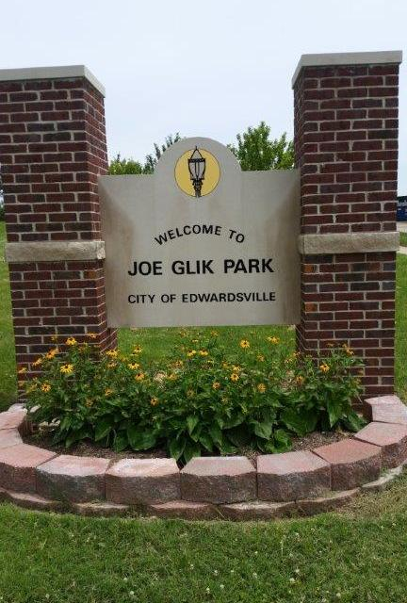
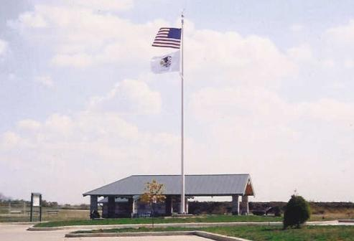

Slide 16
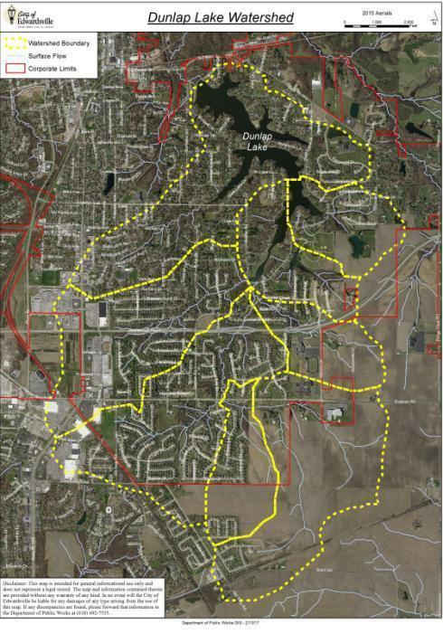

Slide 17
Benefits of City Involvement
  Study the entire storm water management system to include inflow, bank stabilization, regional silt catchment systems, dredging, and outflow.
  Manage the projects with support of city’s professional engineering staff.
    Construction documents
    Bid review
    Value engineering
  Financial benefits
    Grant application partnerships
    Cash upfront to reduce overall borrowing
    Timely borrowing
      - Determine the amount of bond after bids and minimizing interest costs

Slide 18
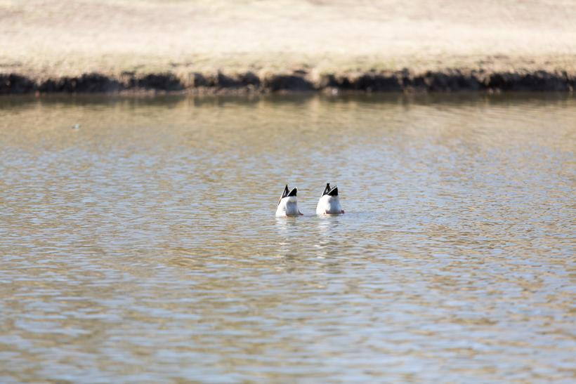
Courtesy of Matt Miller/SmashHousephotography.com

Slide 19
75% of the property owners vote in favor of SSA
City Council votes to establish SSA
City Council votes to:
  Study the watershed
  Engineer the dredging project
  Invest $200,000
  Allocate $100,000 for 2 years after engineering
  ($400,000 total City investment)
  City and County pursue grant funding for $600,000

Slide 20
$15,000 Buy-Out of SSA
  Upfront payment (Buy-Out) allows the DLPOA to borrow less money and lowers interest costs.
  Homeowners are not adding to their tax bill
      Can use this as a positive during home sale (no property tax burden)

Slide 21
$15,000 buyout ($7,500 in 2017 and $7,500 in 2018)
166 paying over $1,000/year
75 agree to $15,000 = $1,125,000
(currently top 75 would cut off at $1,300 or $26,000+)
Every million dollars not borrowed equals $467,000 less in interest payments over a 20-year bond at 4.0%

Slide 22
Sample Ballot
Dunlap Lake Dredging & Sustainability
No – I am against the dredging project as proposed
Yes – I am for the dredging project as proposed
My preferred method of payment is an SSA based on home assessment
My preferred method of payment is a lump sum of $15,000 and not be a part of the SSA
* Please provide your address so the proper SSA boundary can be drawn.

Slide 23

Questions?

Slide 24
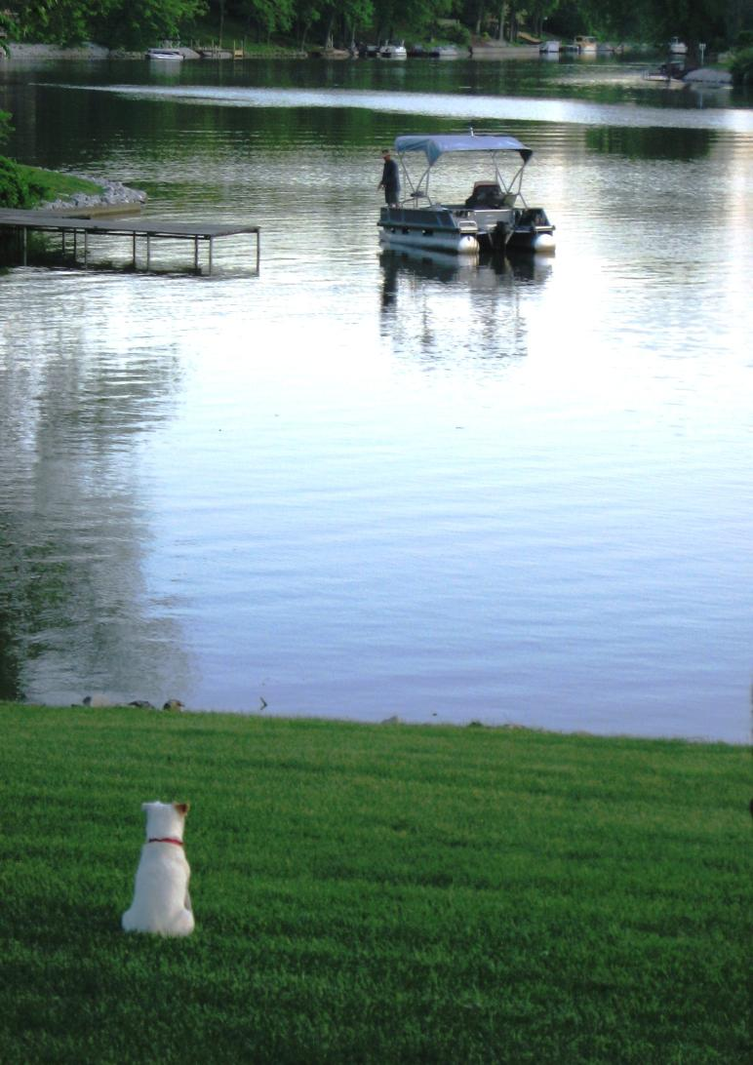

Slide 25
Dunlap Lake
Business Meeting
DLPOA President Alan Ortbals

Slide 26
Petition to exit/Request to join DLPOA
Explanation of requests
Options for response
Discussion
Any change to the boundaries would take serious evaluation, input from attorney, and a vote of the full membership.

Slide 27
Board Introductions
Larry Ahrens
Greg Brumitt
Lee Frea
Walter Heck
Mark Hicks
Patrick Hill
Andy Leek
Craig Louer
Genie Manterfield
Jim Seubert
Todd Smith
Michael Watts
Roy Wehling
Richard Welle
Association Manager – Carolyn Green, C. Green & Assoc, Inc
Financial Coordinator – Tori Frea

Slide 28

New Candidate
Introductions & Elections
Tim Brown, 11 North Shore Dr.
Greg Brumitt, 537 East Lake Dr.
Genie Manterfield, 313 Thomas Terrace
Donna Polinske, 16 North Shore Dr.
Jim Seubert, 113 West Lake Dr.
Jim Taylor, 133 Lotus Dr.
Rick Welle, 843 East Lake Dr.
Other nominations or volunteers

Slide 29
2016-17 Financial Report
Proposed FY 2017 Budget
Treasurer - Chief Richard Welle

Slide 30
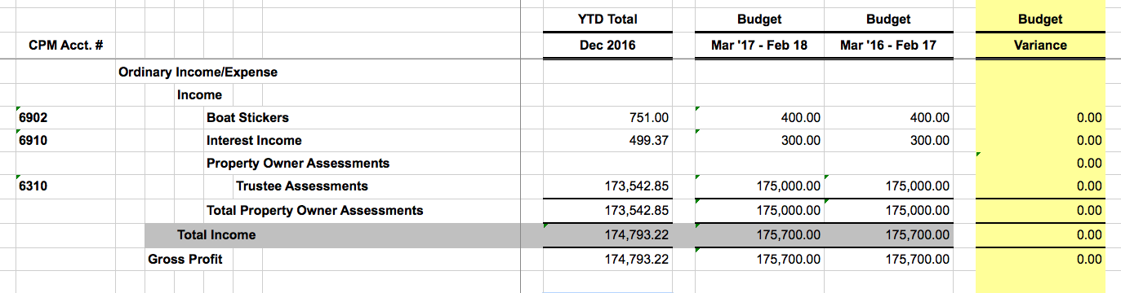
Income

Slide 31
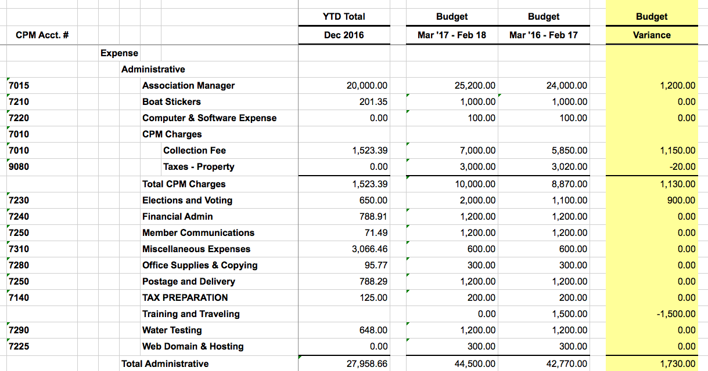
Expenses

Slide 32
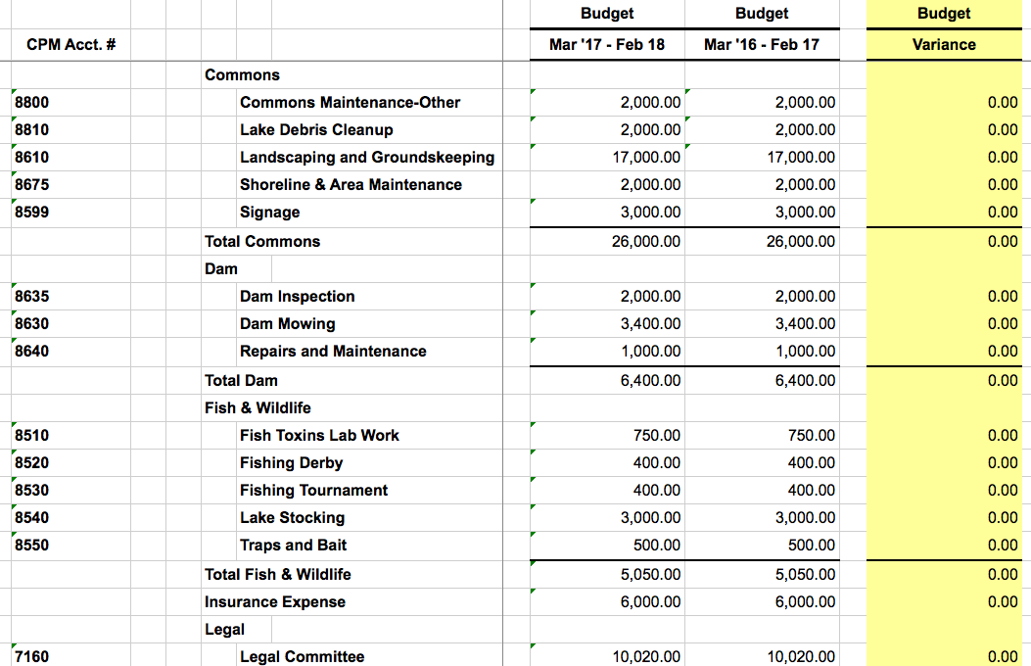
Expenses

Slide 33
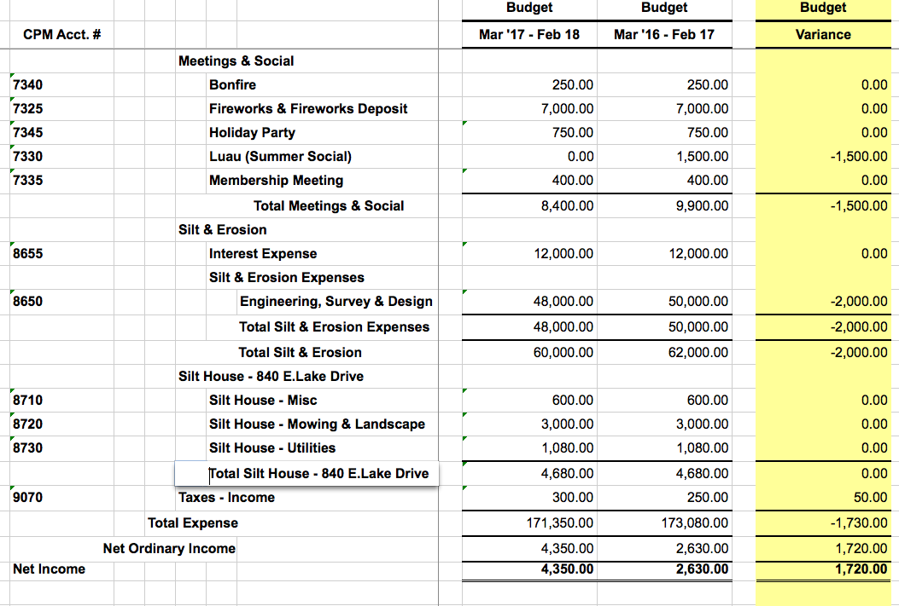
Expenses

Slide 34
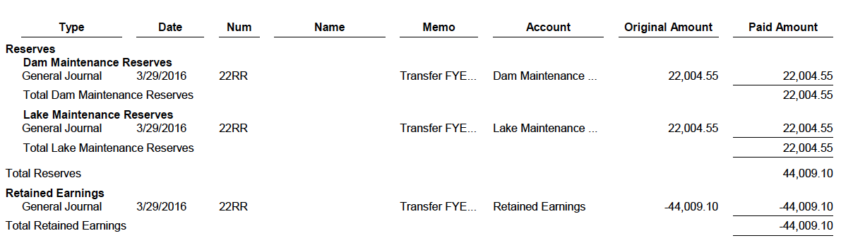
DLPOA Reserves
March –December 2016

Slide 35
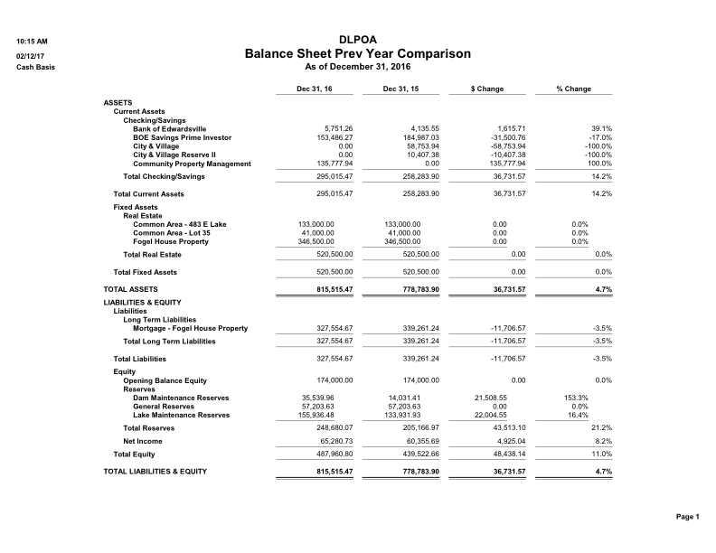
Balance Sheet/Previous Yr Comparison

Slide 36
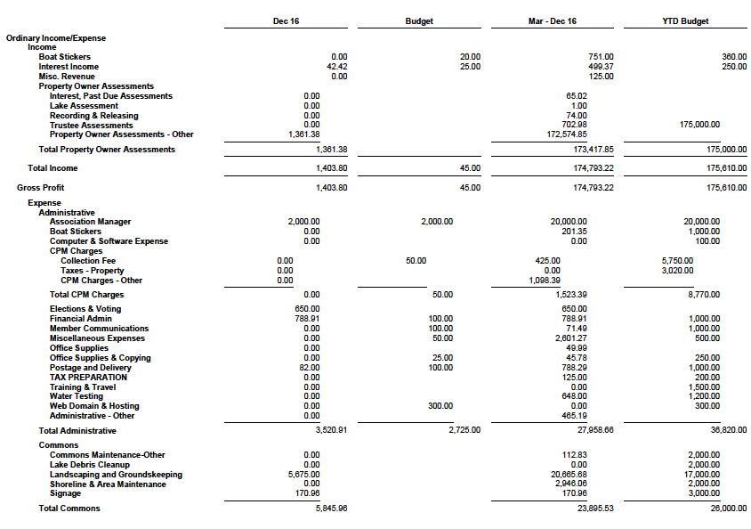
Profit & Loss Dec. 2016 (page 1)

Slide 37
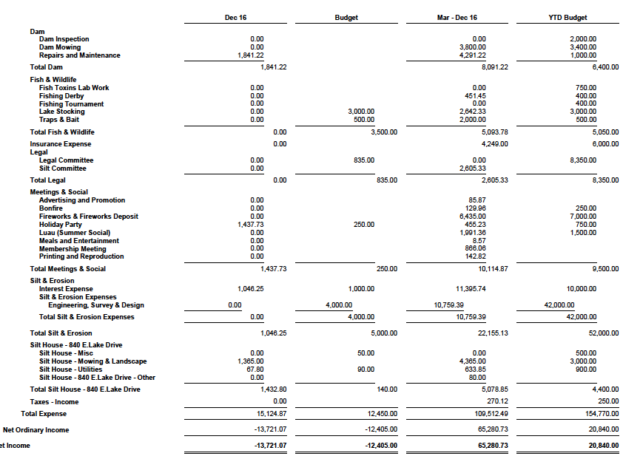
Profit & Loss Dec. 2016 (page 2)

Slide 38
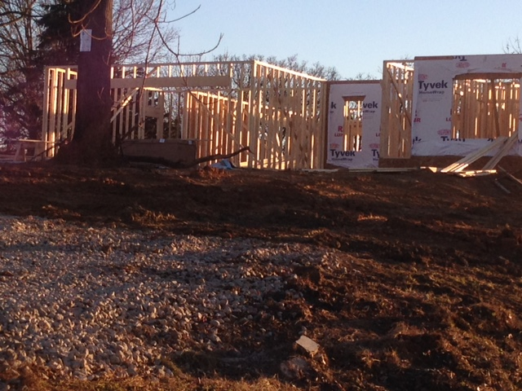
Building Committee
Andy Leek, Chair

Slide 39
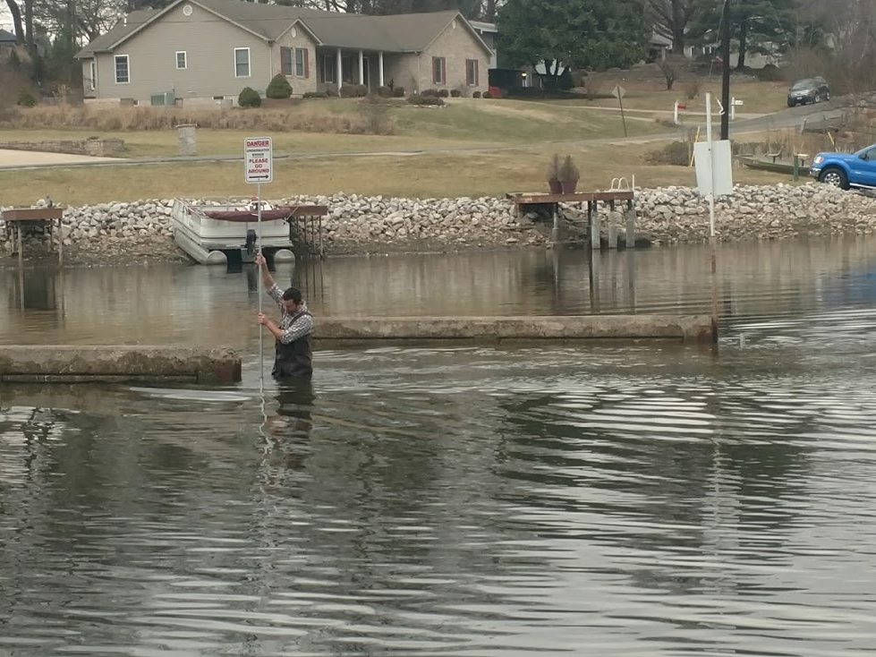
Commons Committee
Lee Frea, Chair

Slide 40
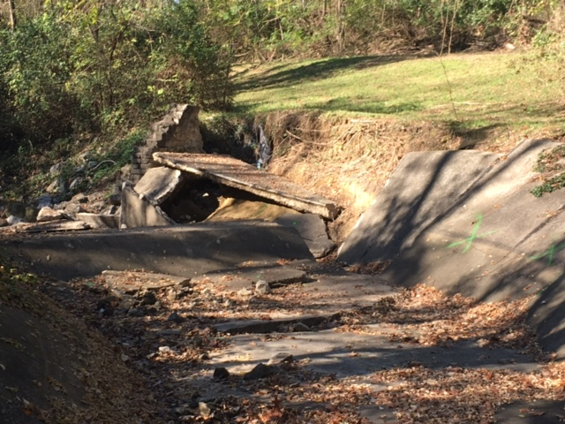
Spillway dissipater November 2016
Dam Maintenance Committee
Michael Watts, Chair

Slide 41
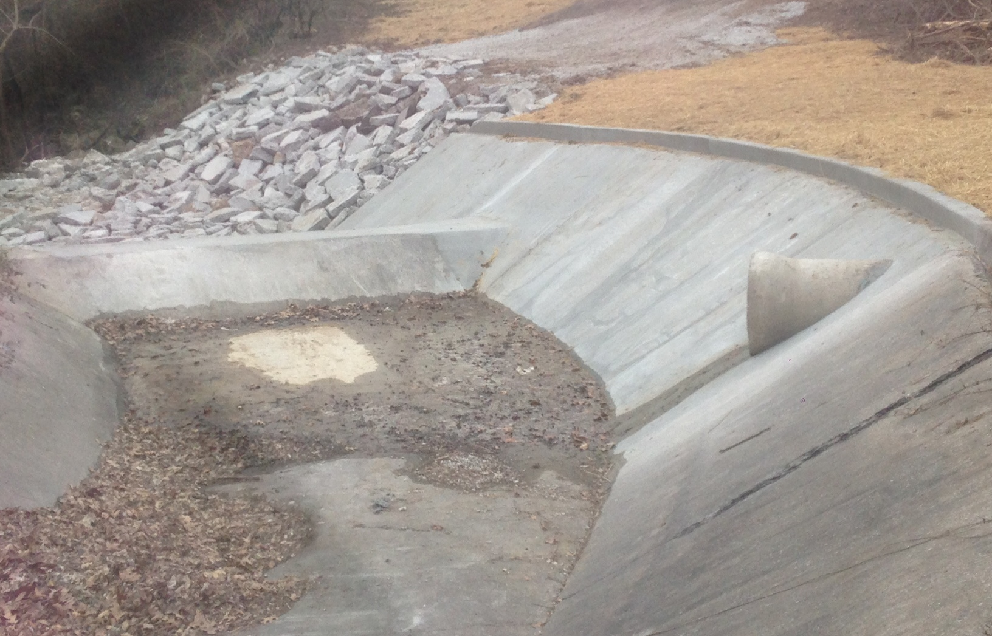
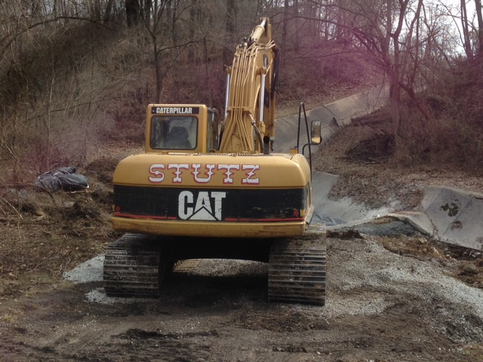
Spillway dissipater February 2017

Slide 42
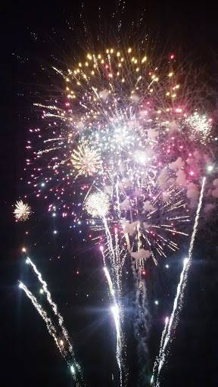
Fireworks
Michael Watts, Chair

Slide 43
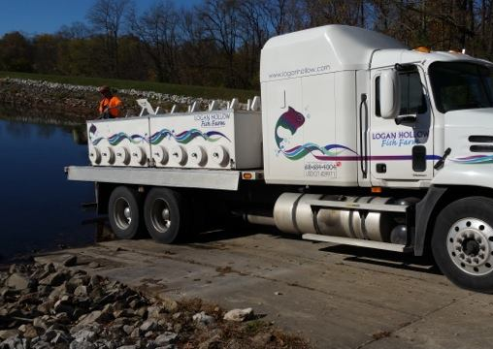
Fish & Wildlife Committee
Walter Heck, Chair

Slide 44

Meetings, Elections & Social Committee
Jim Seubert, Chair

Slide 45
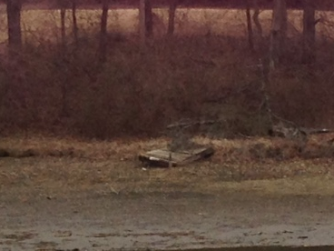
Restrictions Committee
Roy Wehling, Chair

Slide 46
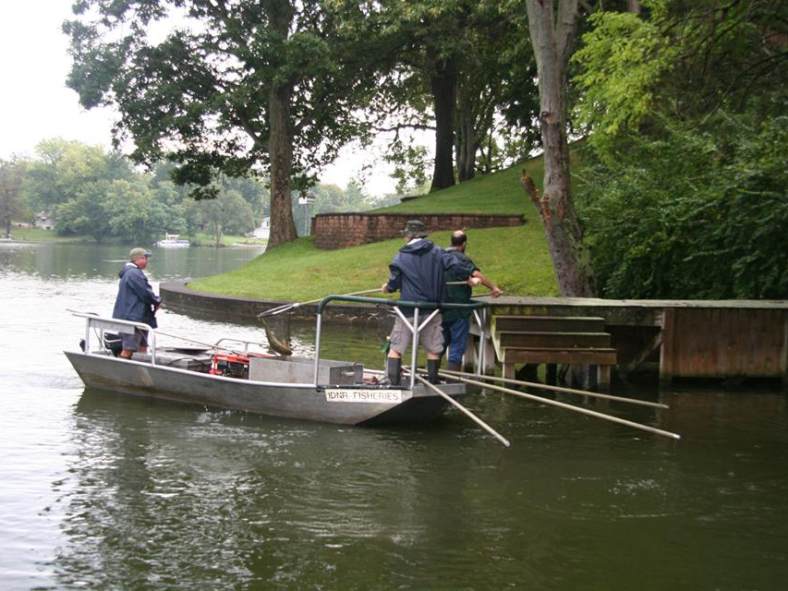
Safety Committee
Mark Hicks, Chair

Slide 47

Website – Todd Smith
Dunlap Lake has 278 followers on Facebook
Website peak - July 3 2016 with 553 in one day.
Summer months average 2000 page views a month
In winter we average around 700 a month on average

Slide 48
Wrapping Up
Election Results
  One 2-year term
New Business
Adjournment

Slide 49
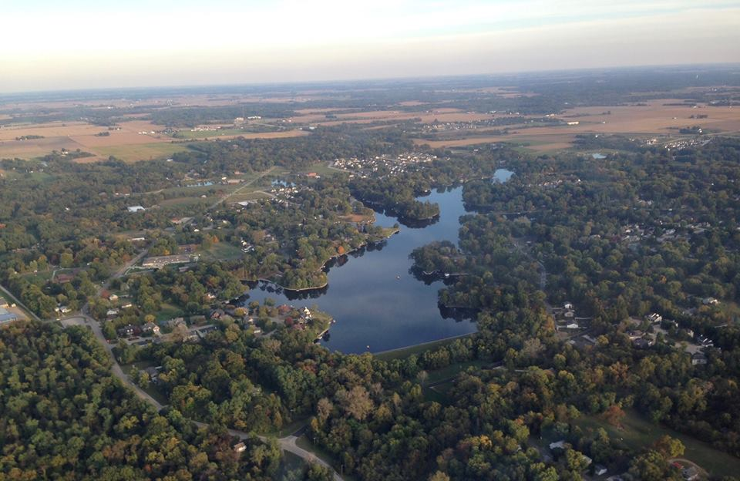
Thanks for Attending!
Make sure to check out our website at WWW.DUNLAPLAKE.ORG
and like us on Facebook at www.facebook.com/dunlaplake
for your Dunlap Lake Property Owner’s Association News!

